Slide 1
Kogi state ministry of budget and planning,lokoja.
Stakeholders townhall meeting on year 2020 budget formulation
DATE-05-11-2019
TIME-10:00AM
VENUE
IGBO HALL,DADA ONICAR JUNCTION,KABBA,KOGI STATE

Slide 2
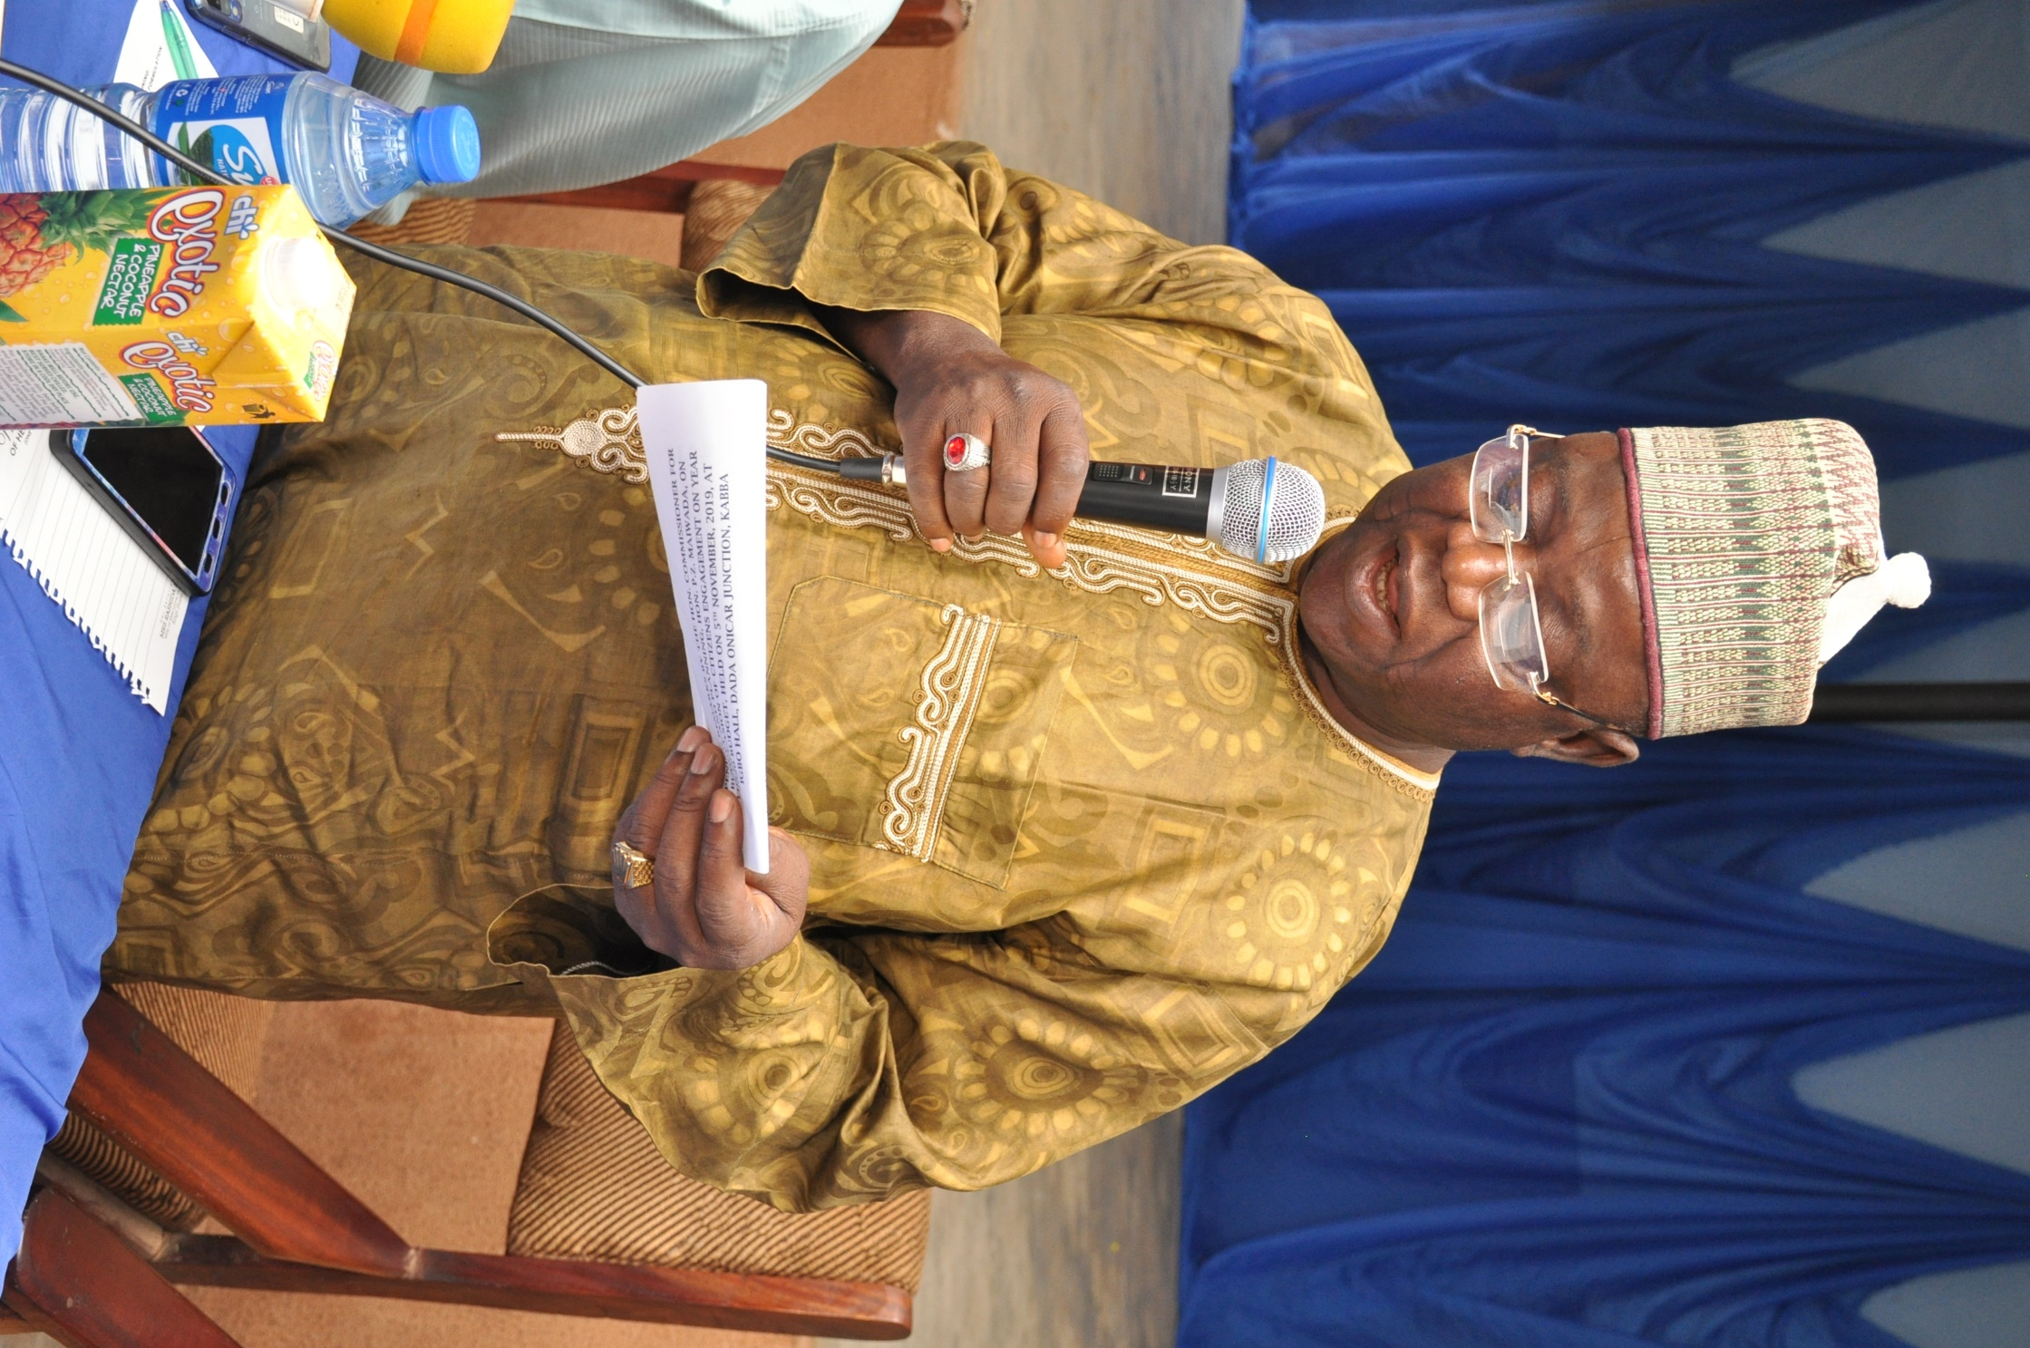
COMMISSIONER OF BUDGET AND PLANNING,
HON.PAUL MAIWADA
Hon.paul maiwada delivering the opening remarks on the occasion of citizens engagement on year 2020 Budget.

Slide 3
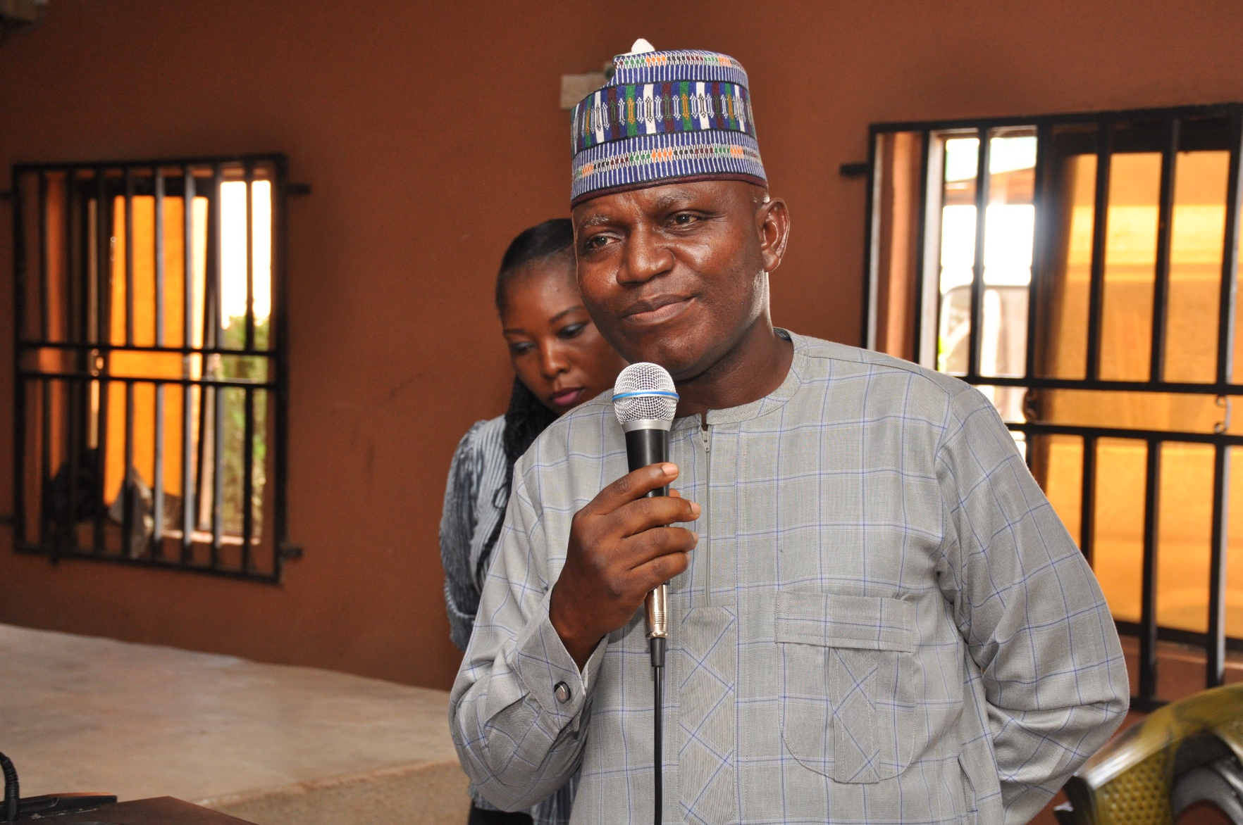
DIRECTOR OF BUDGET,MINISTRY OF BUDGET AND PLANNING,LOKOJA.
MR. SANNI, H.M

Slide 4
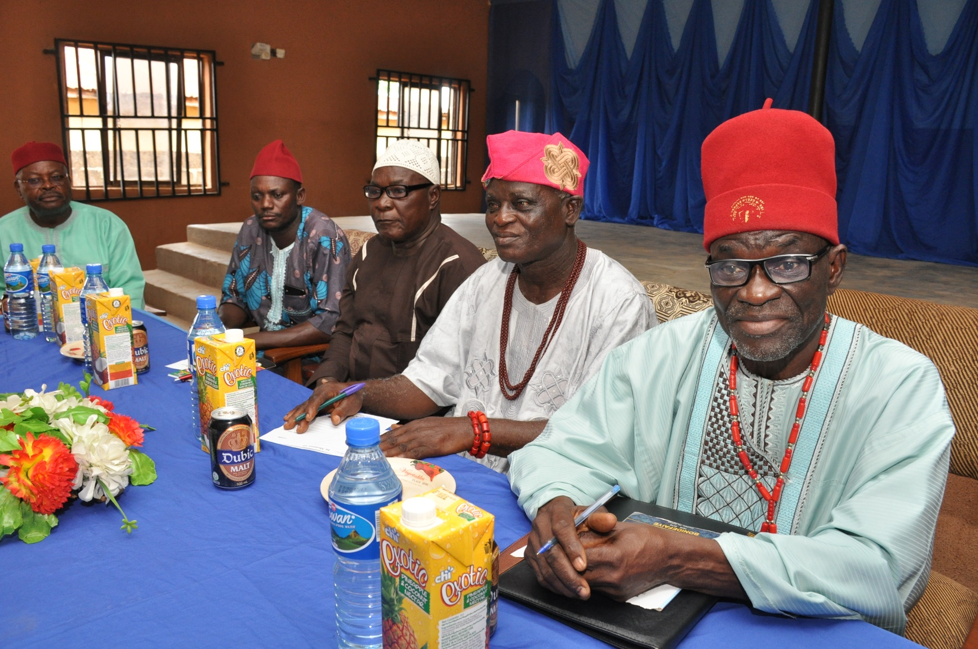
ROYAL FATHERS FROM THE KABBA TRADITIONAL COUNCIL

Slide 5
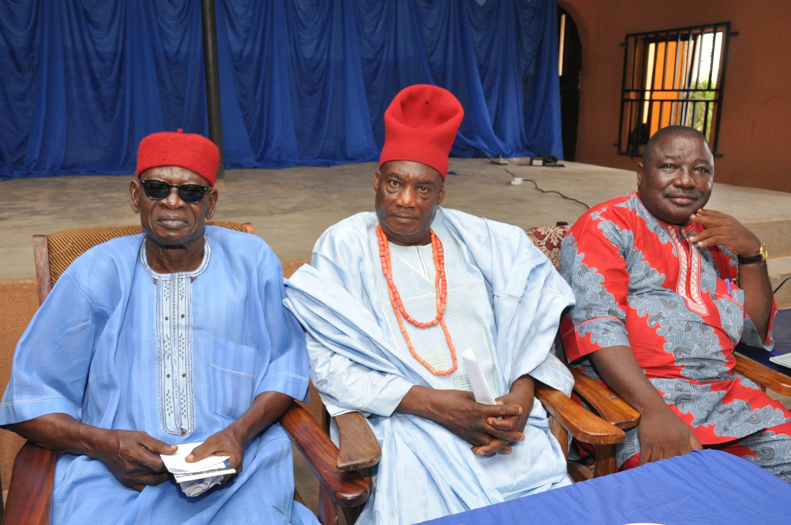
ROYAL FATHERS AND MR. E. BAYODE(THE LEAD SPEAKER)

Slide 6
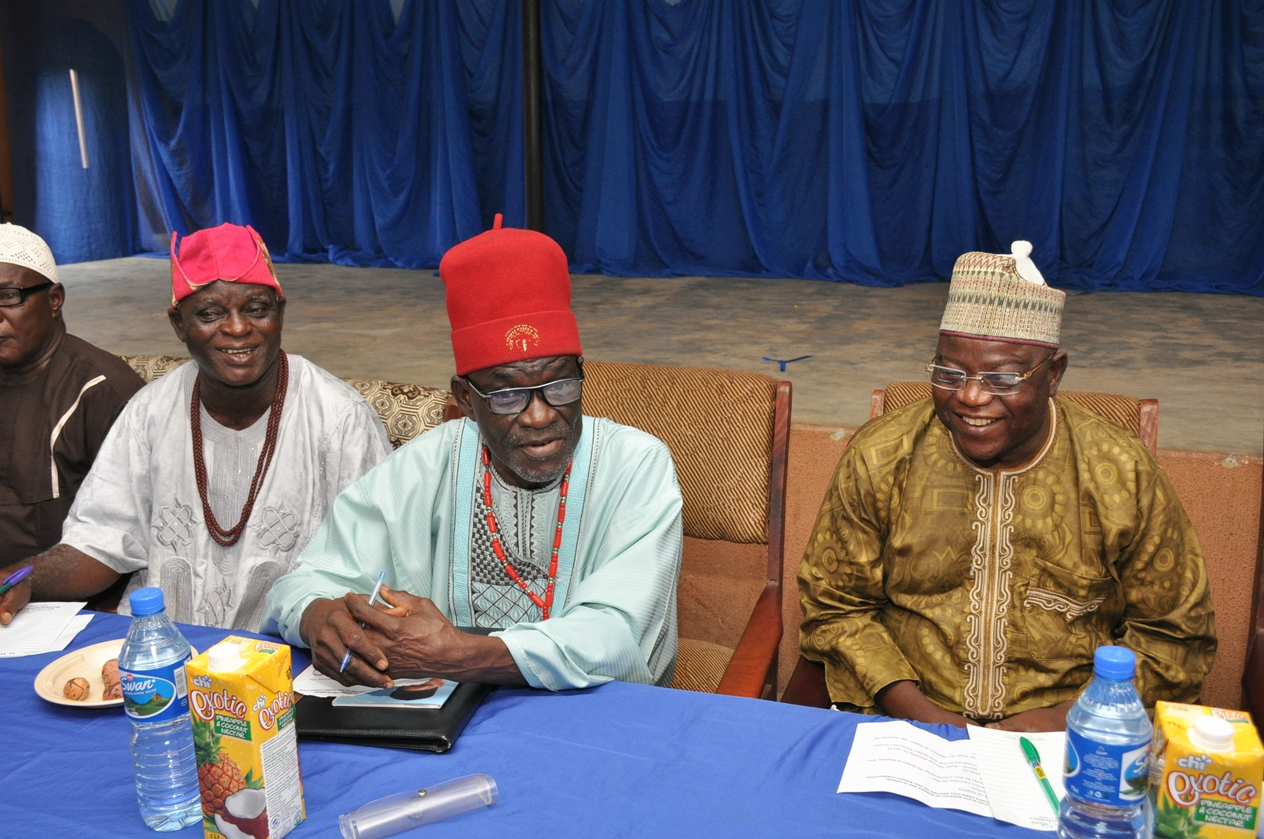
Royal fathers and Commissioner for budget and planning.

Slide 7
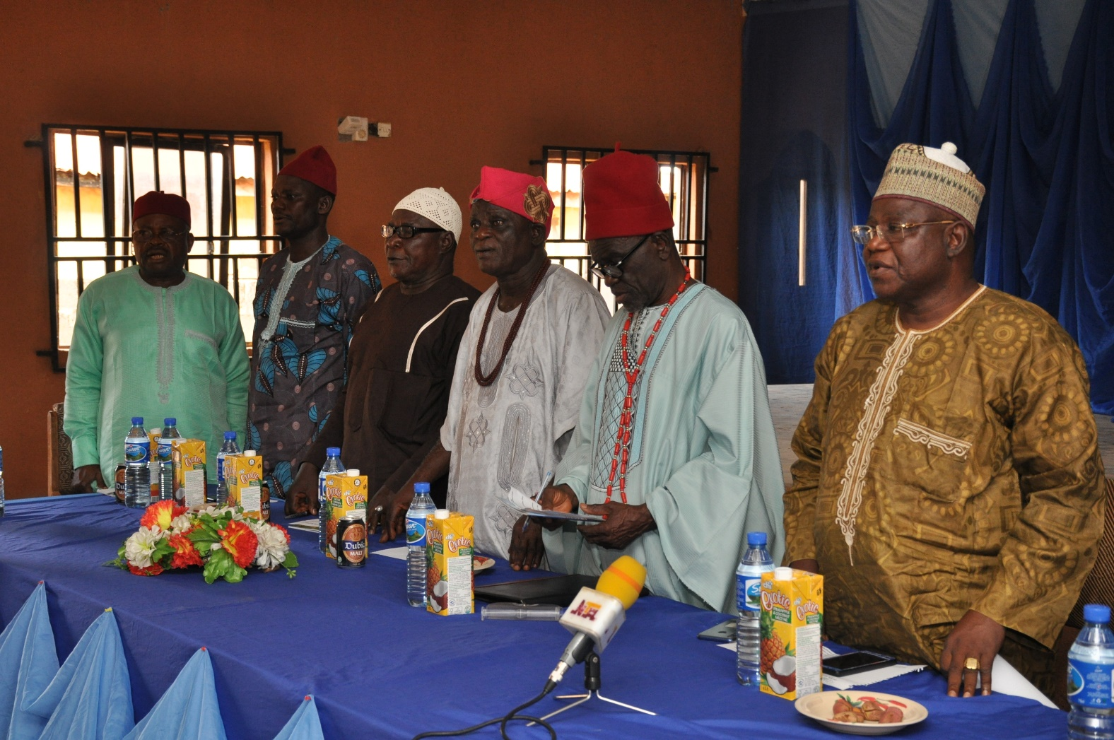
Royal fathers and commissioner for budget and planning,hon. Paul maiwada at attention for the national anthem

Slide 8
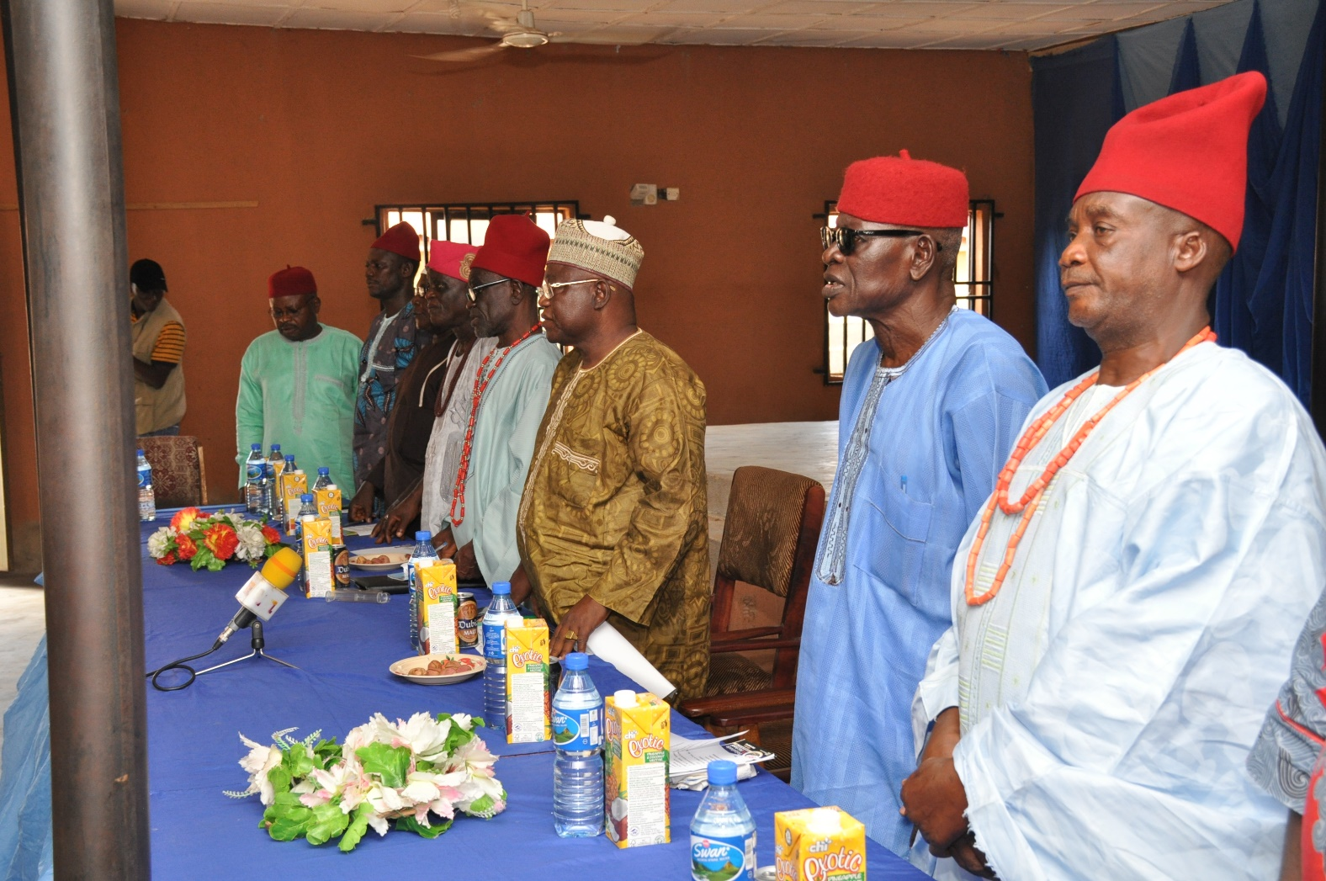
Dignitaries at attention for the national anthem

Slide 9
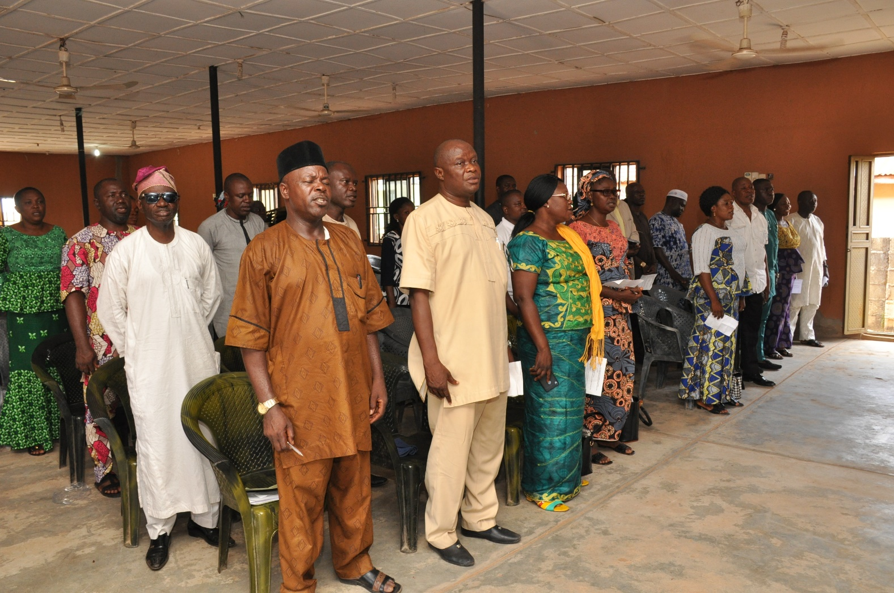
Participants at attention for the national anthem

Slide 10
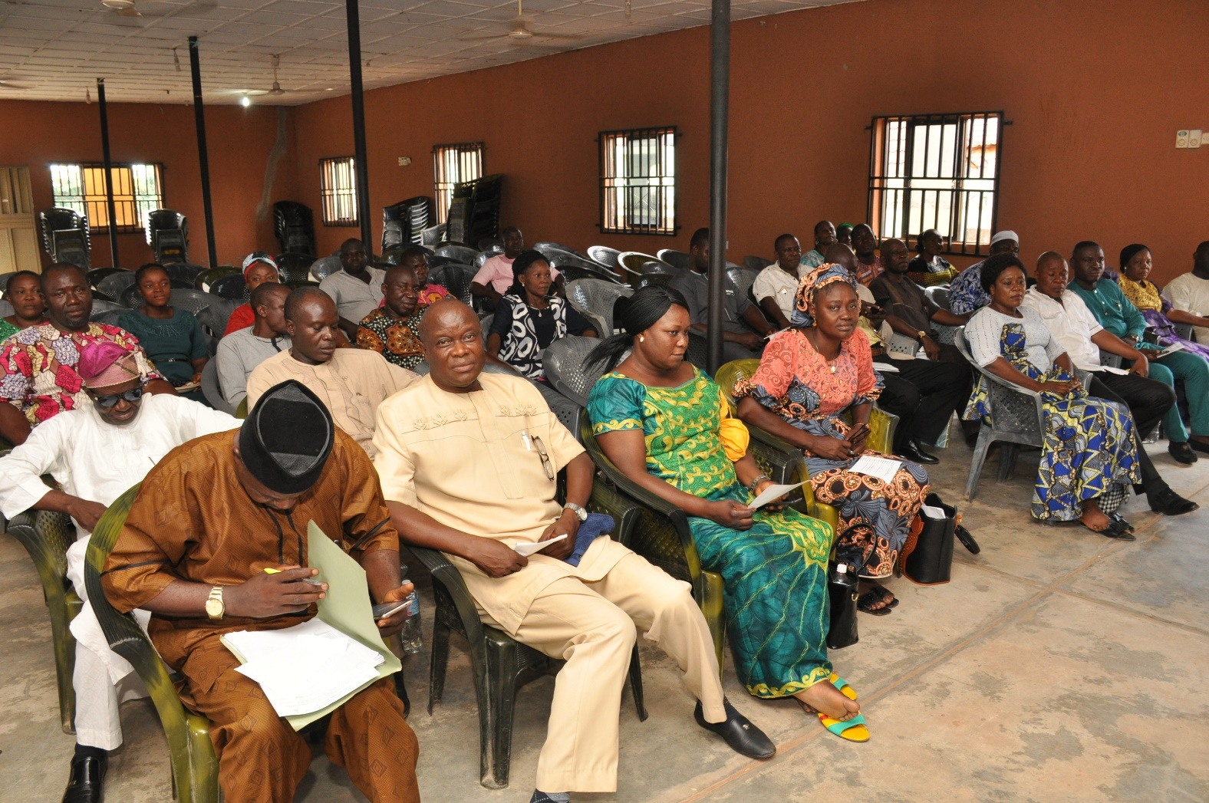
Participants at the stakeholders townhall engagement at kabba,kogi state.

Slide 11
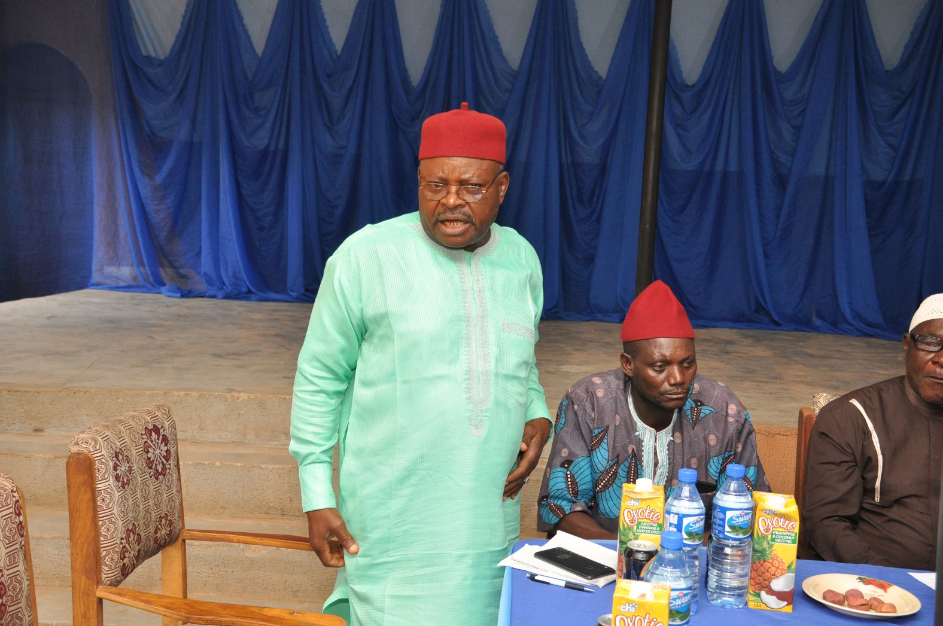
Royal father from kabba explaining a point during the meeting

Slide 12
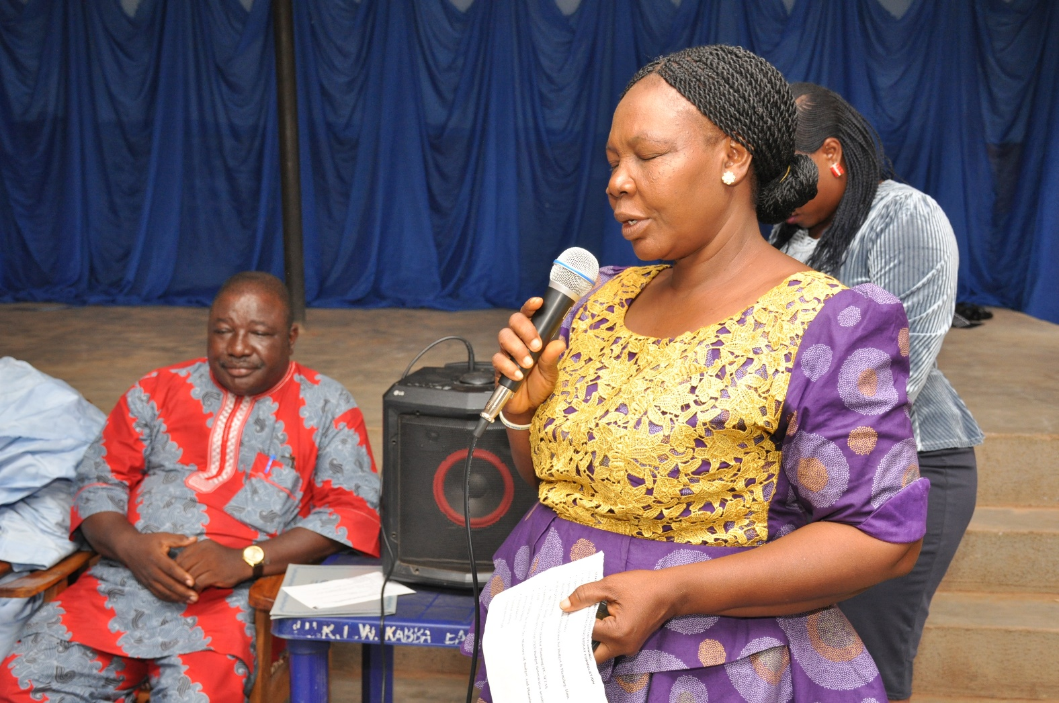
A participant responding to issues raised at the meeting

Slide 13
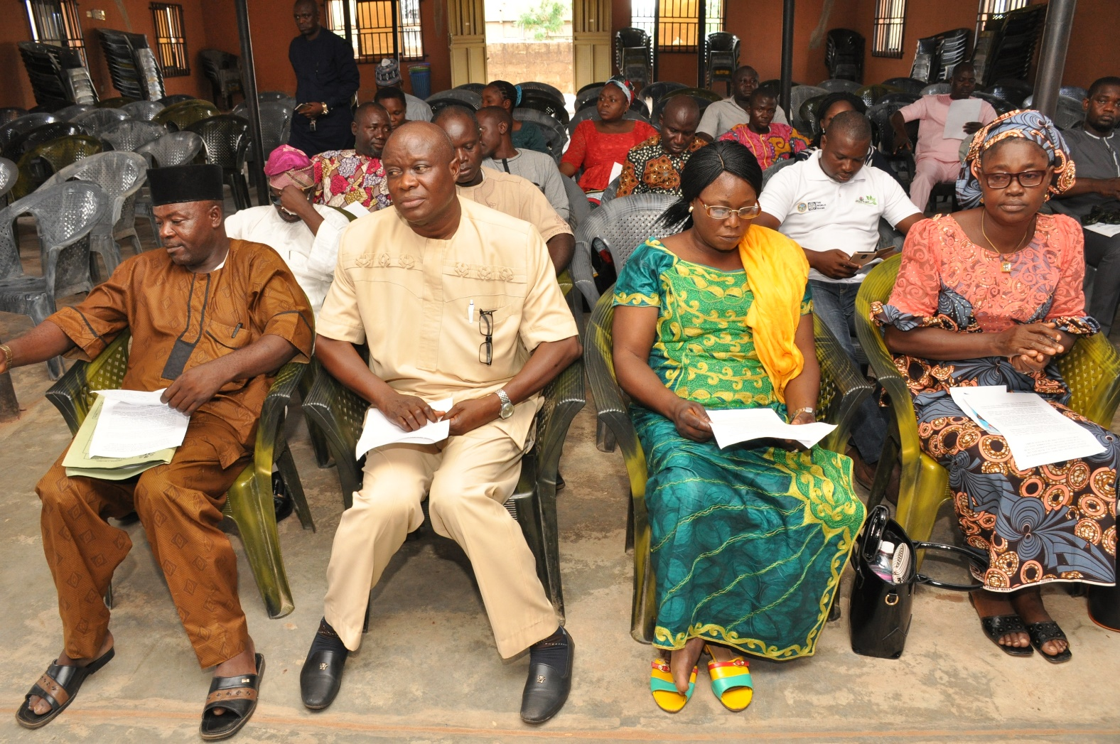
Participant listening attentively to the speakers

Slide 14
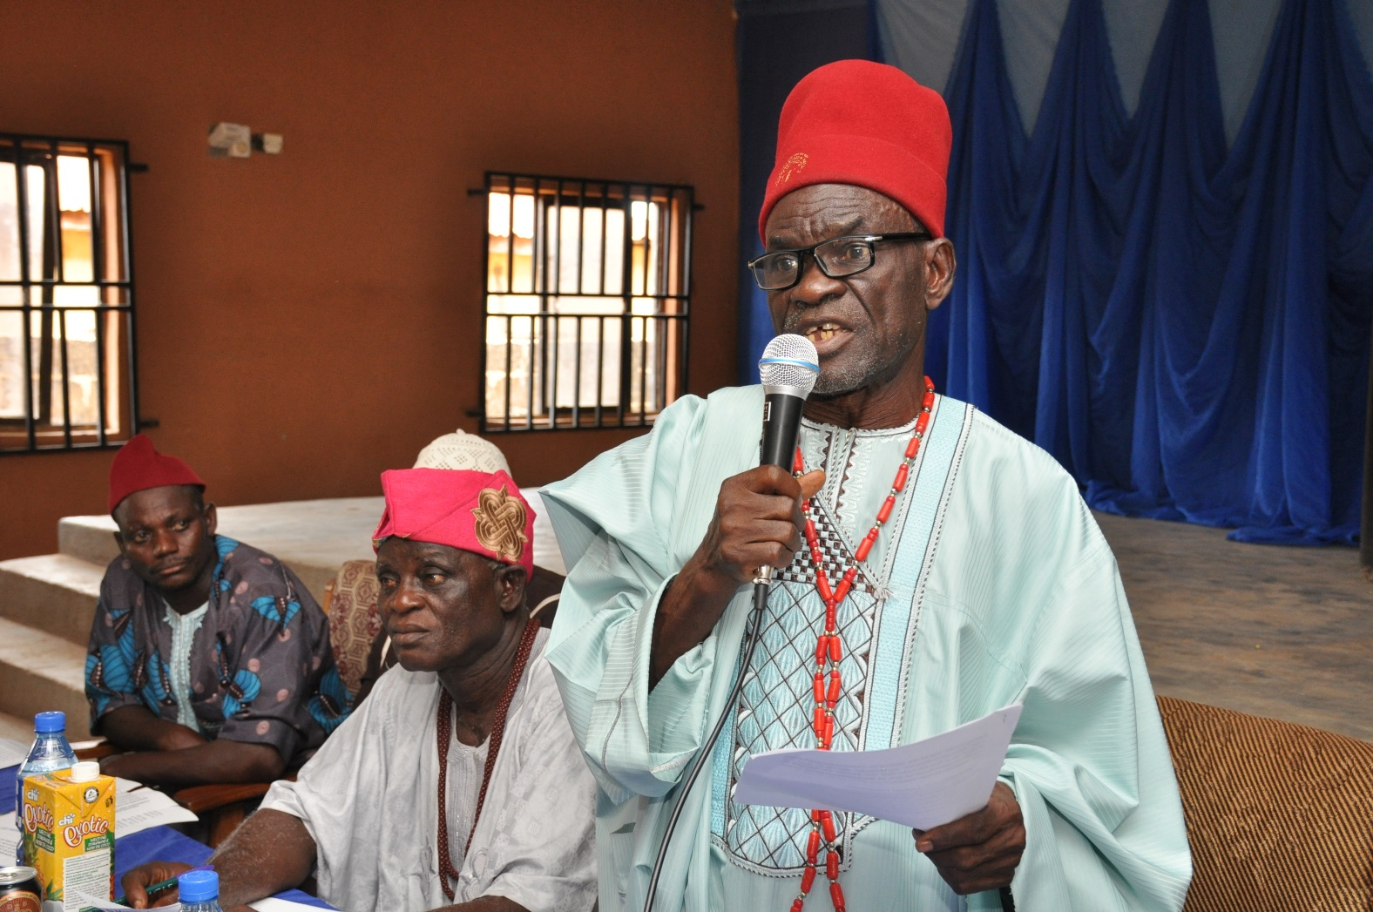
Royal father responding to the speakers

Slide 15
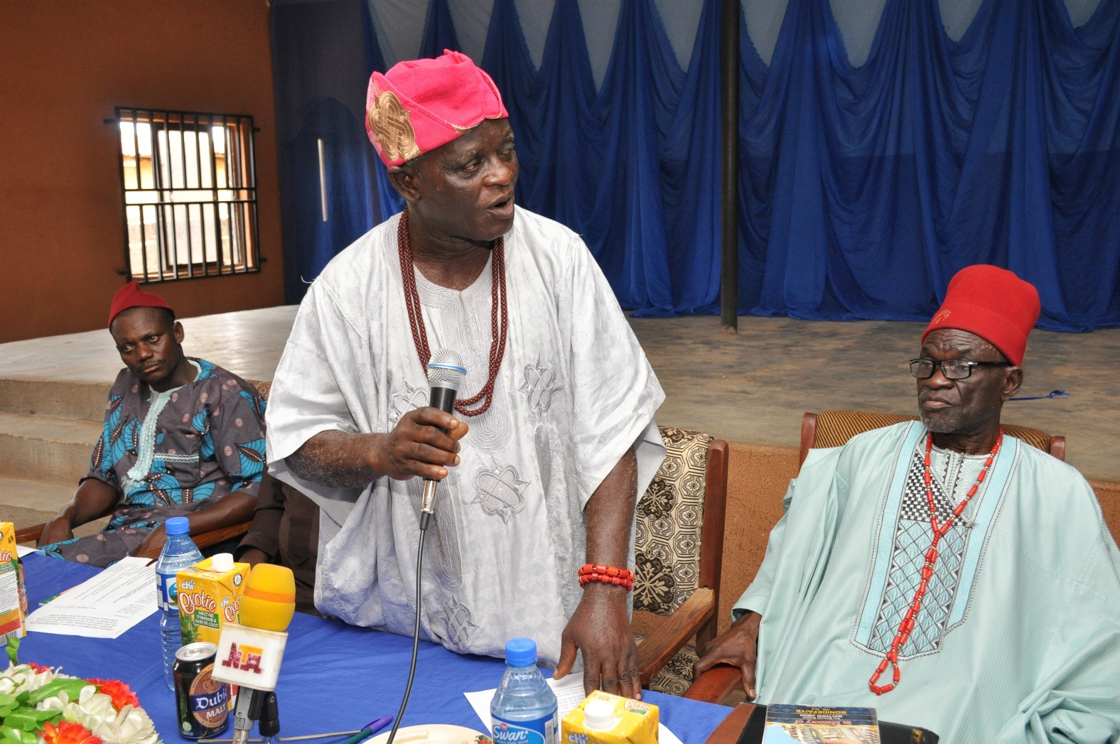
Royal father reacting to issues raised

Slide 16
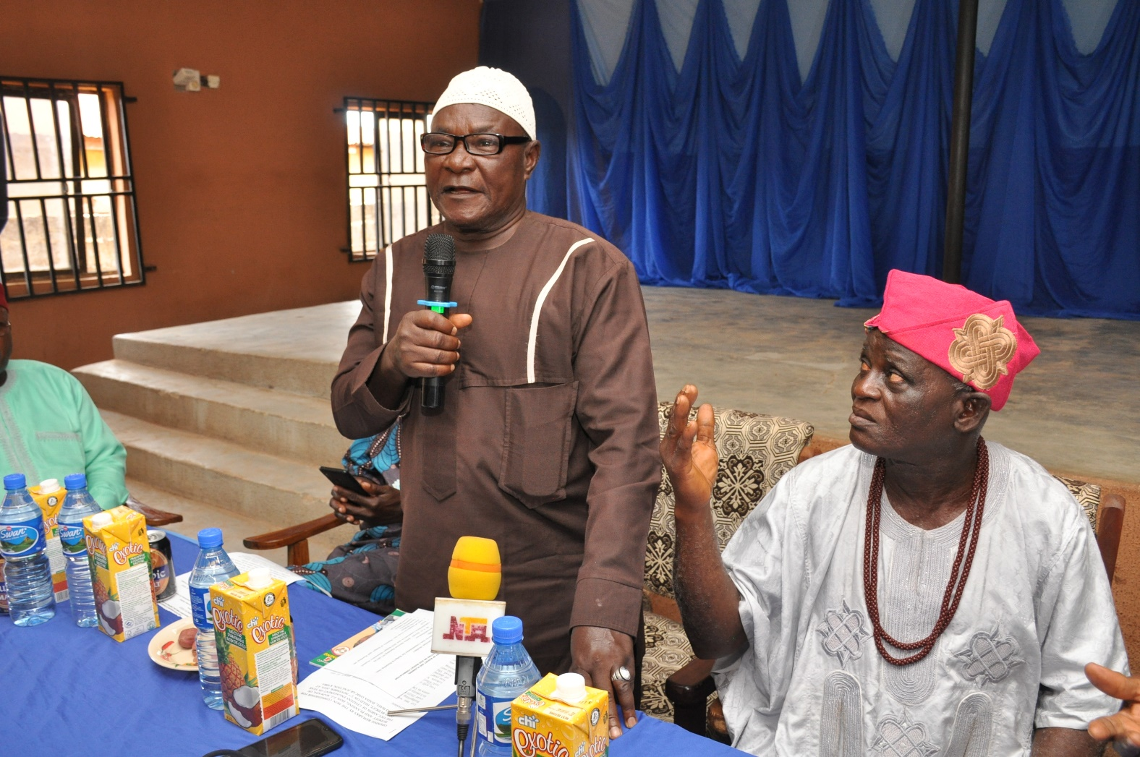
Royal father contributing to the discussion

Slide 17
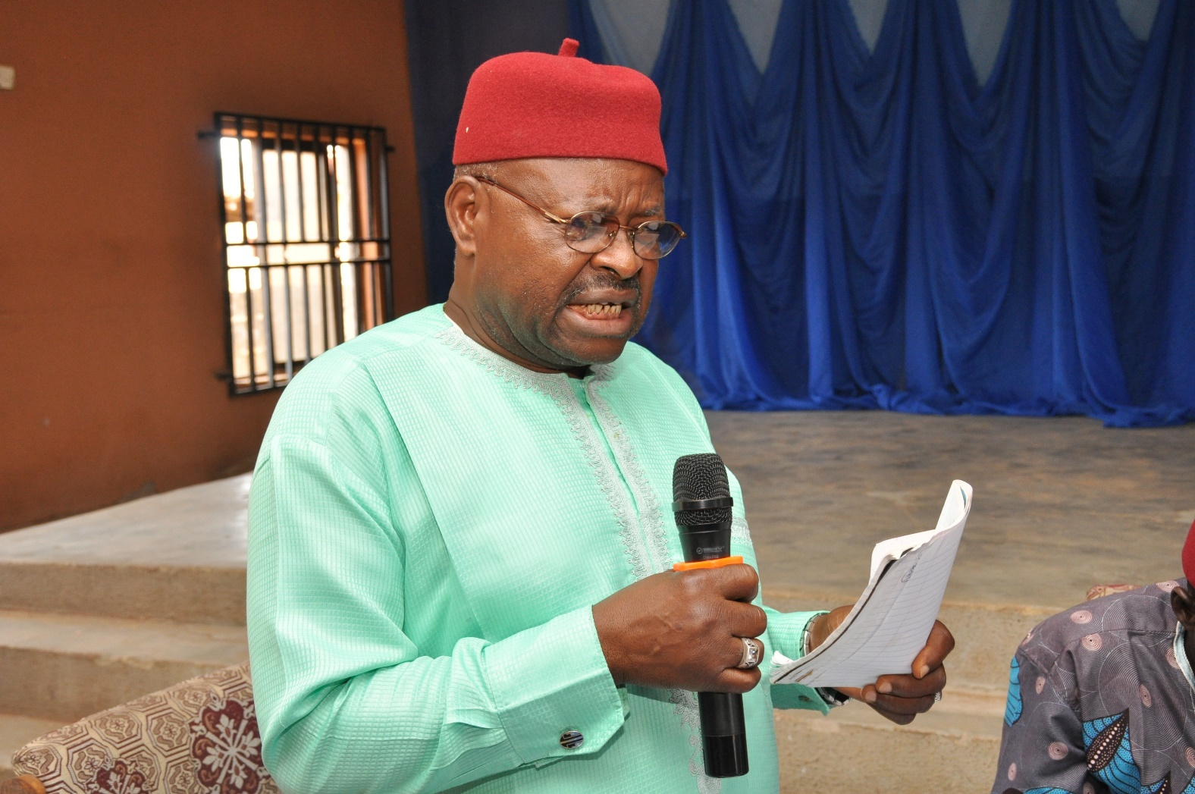
One of the royal fathers reading out list of the community demands

Slide 18
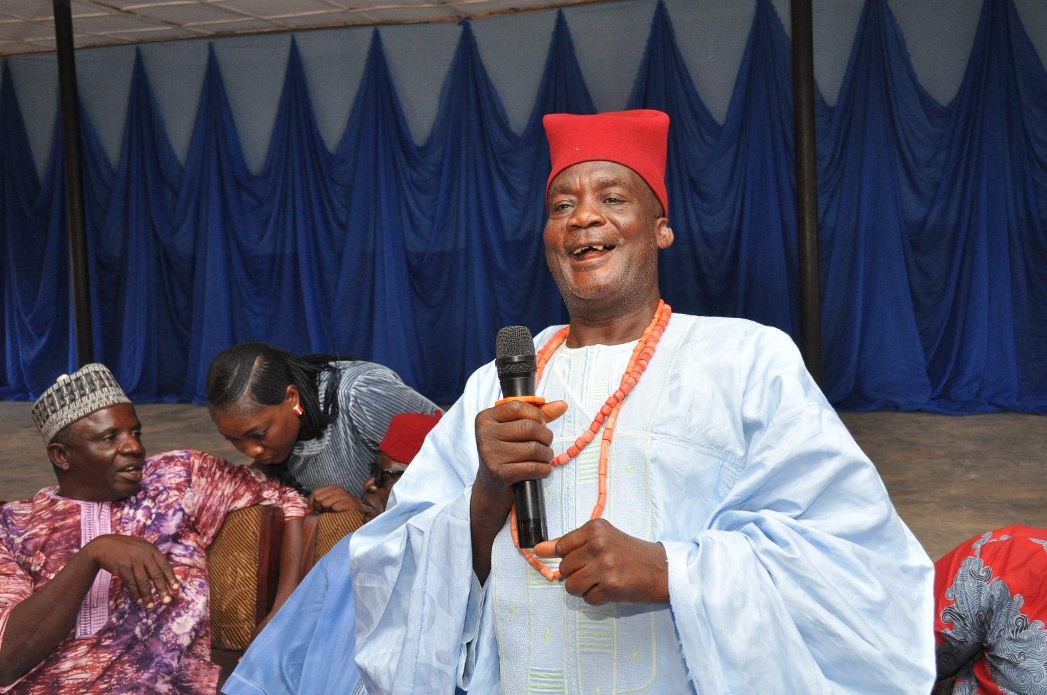
The royal father explaining a list of their demands

Slide 19
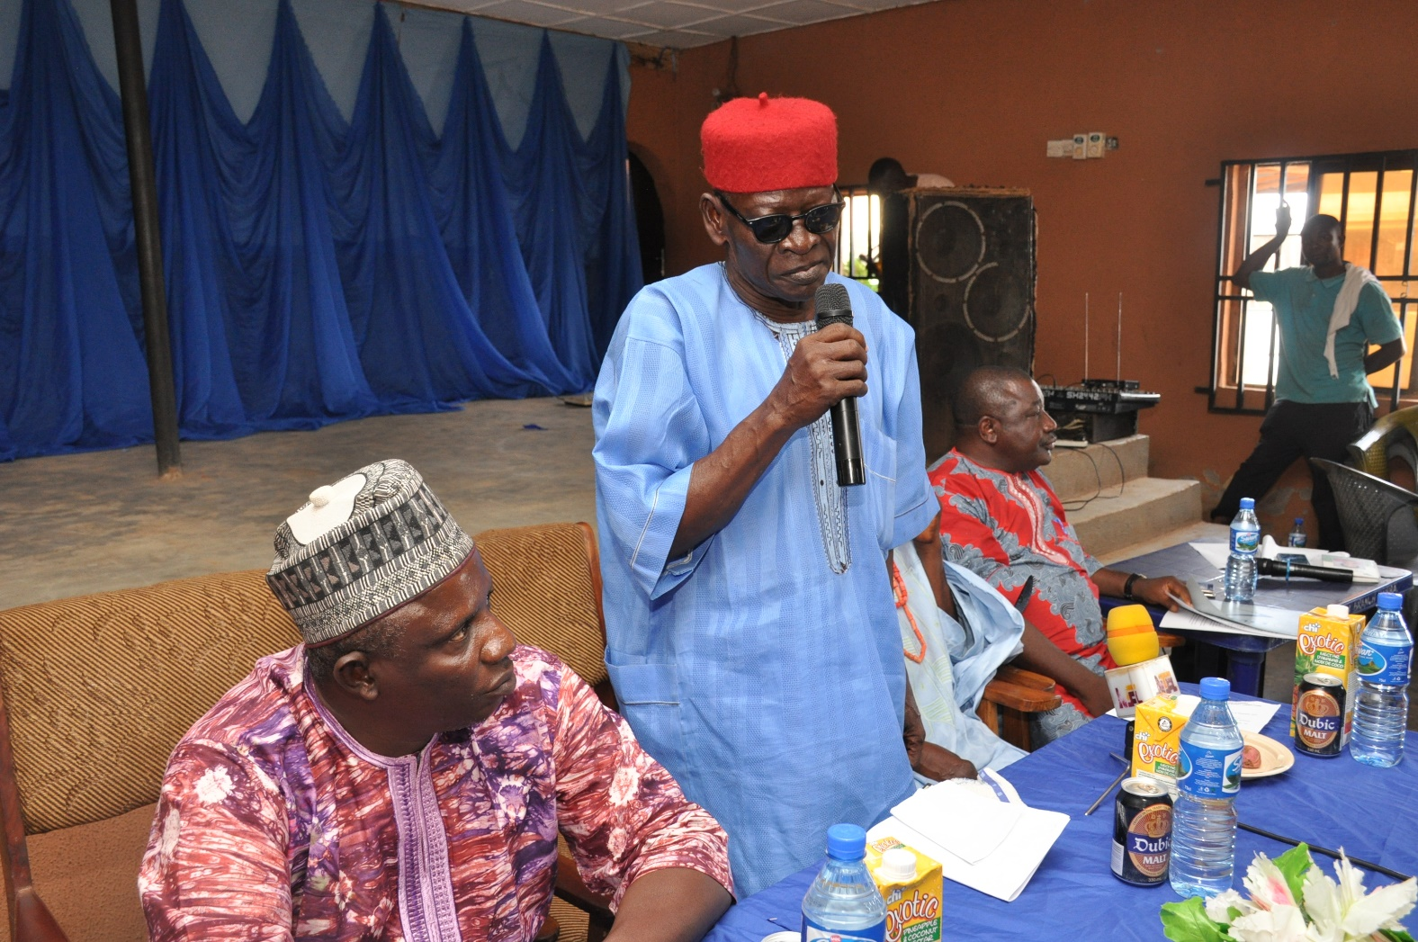
One of the royal father delivering the wish list of the community

Slide 20
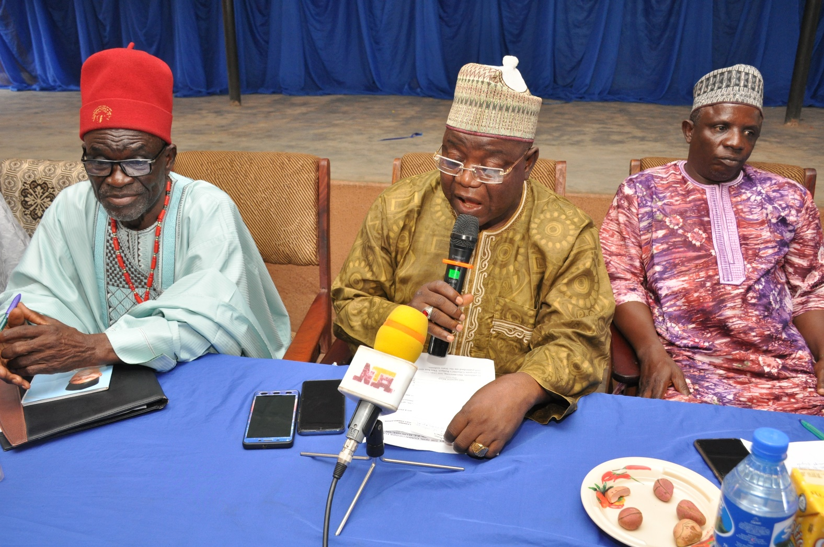
The commissioner of budget and planning,hon.paul maiwada responding to issues raised

Slide 21
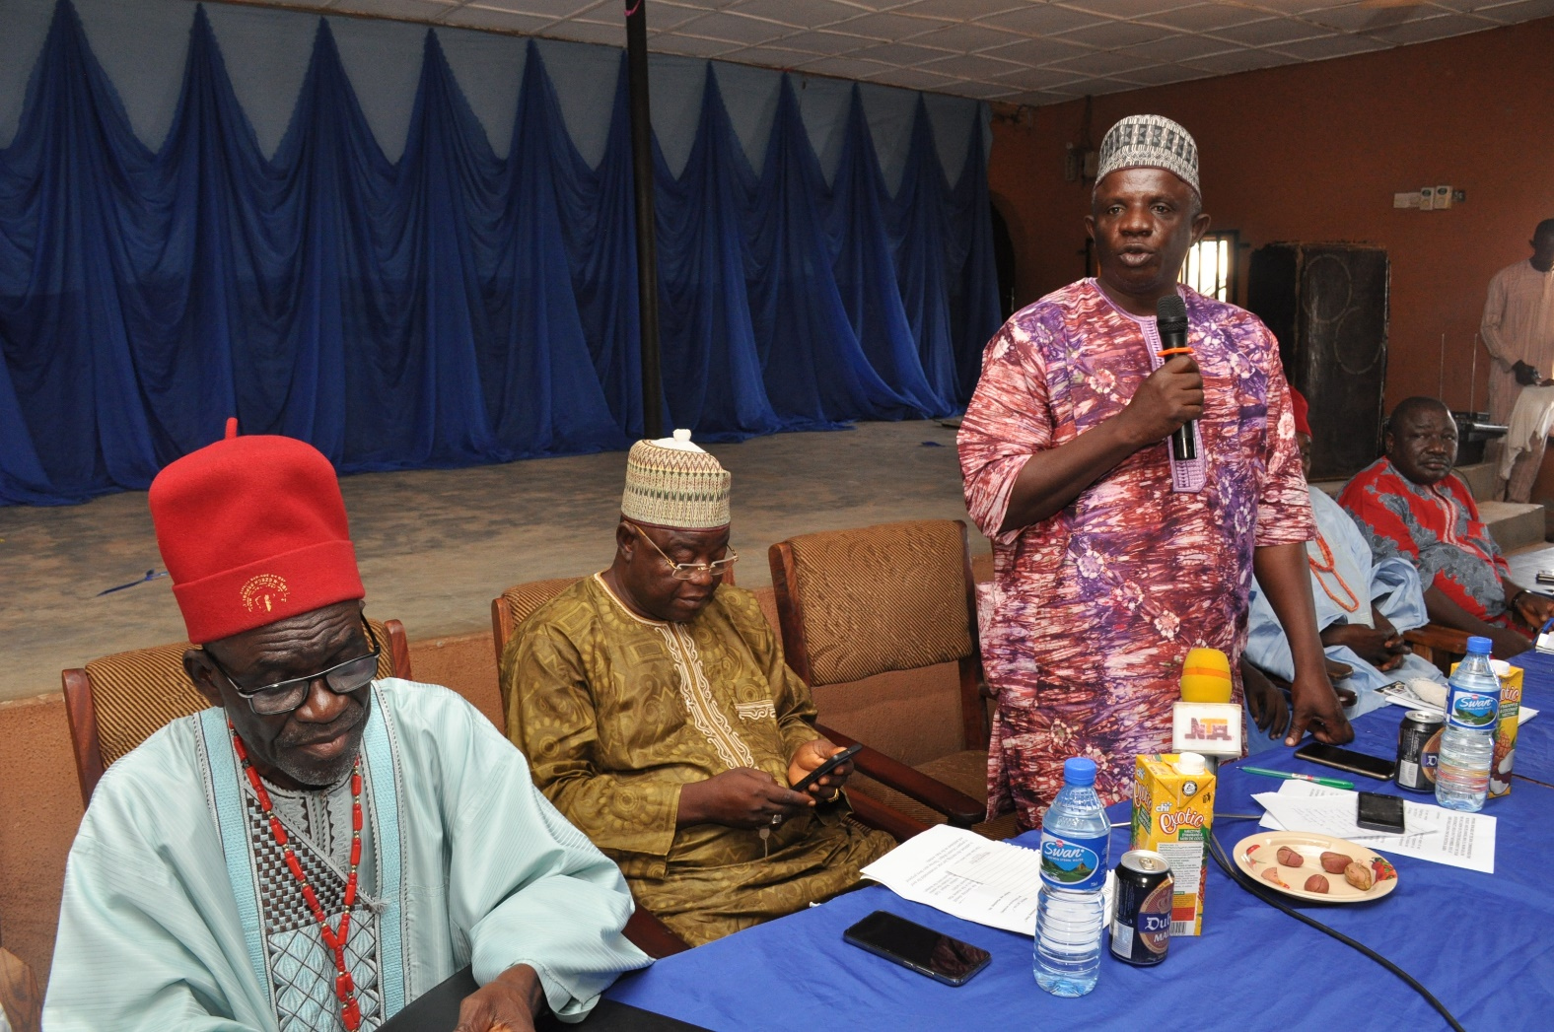
Permanent secretary,ministry of budget and planning,mr. p.o Stephen responding to the points raised

Slide 22
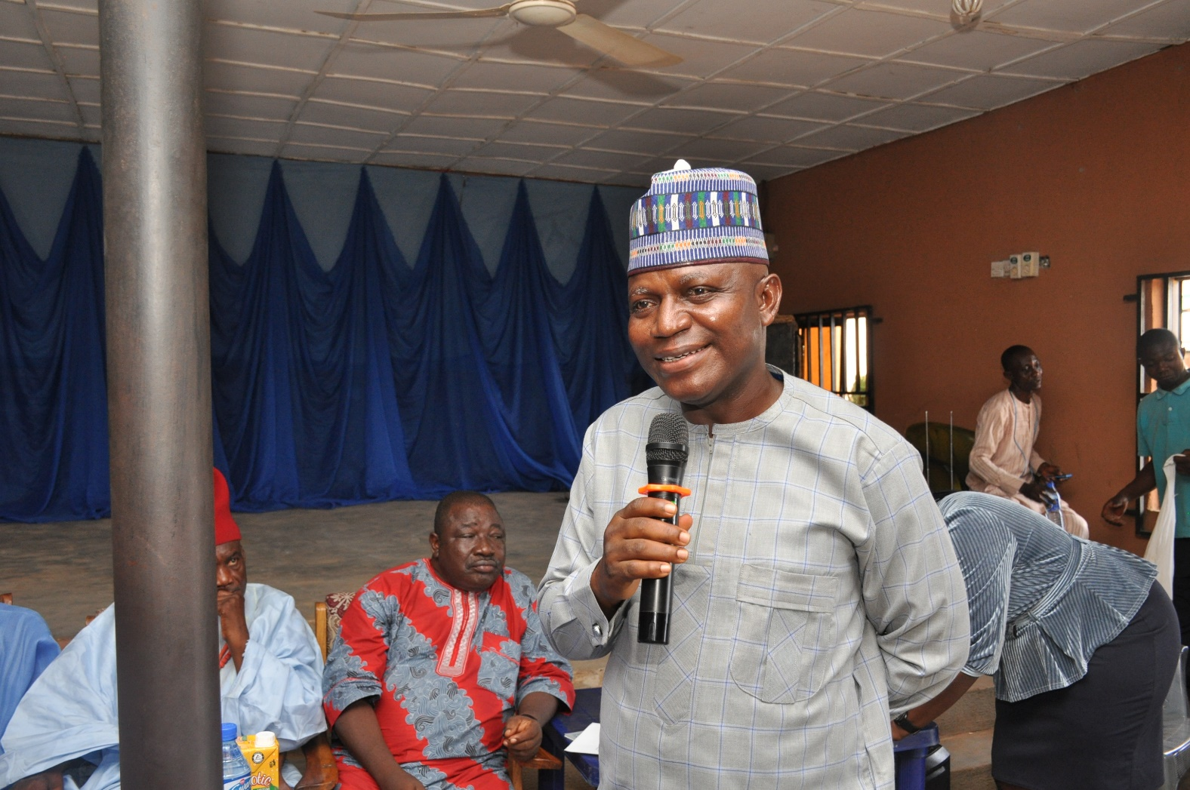
The director of budget also responding to issues raised at the stakeholders meeting.

Slide 23
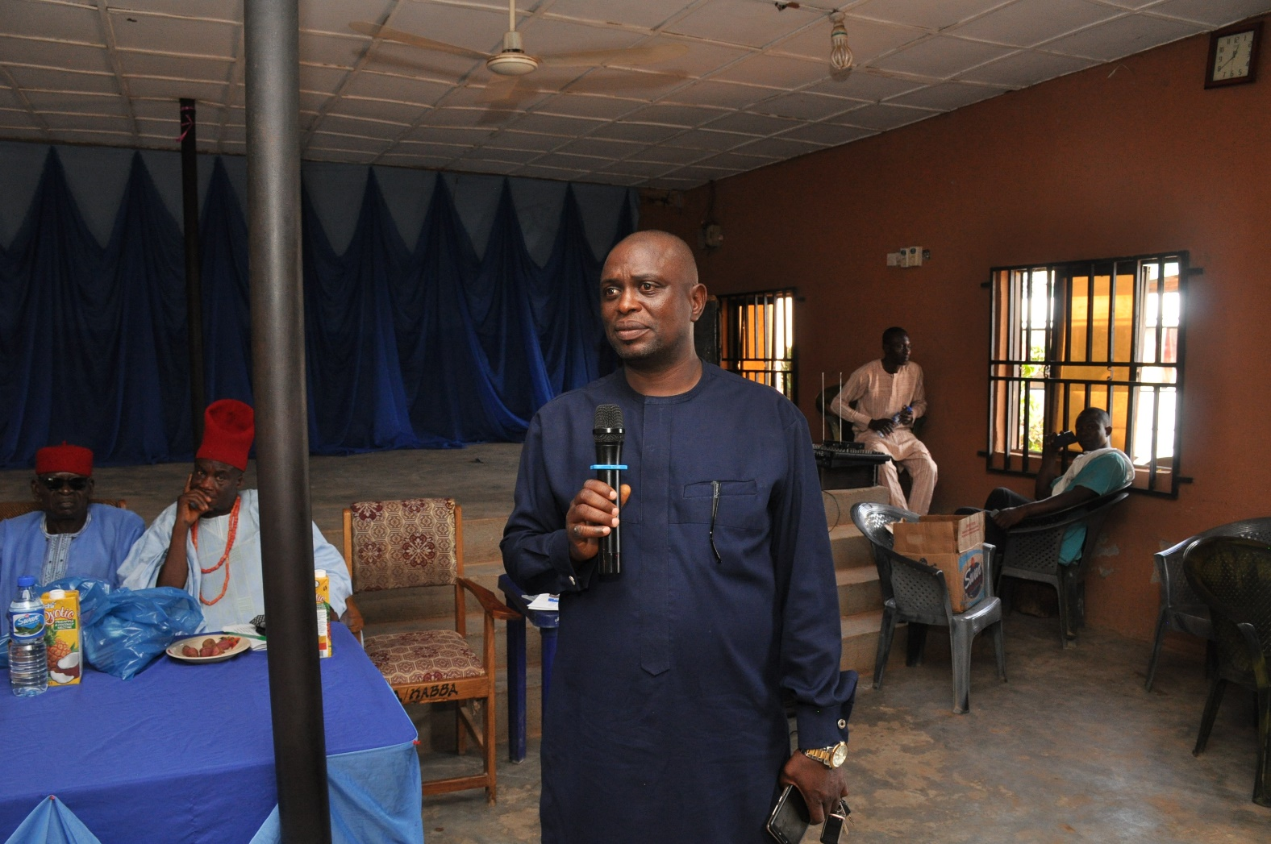
Asst. director of budget,mr. olajide responding to issues during the stakeholders engagement.

Slide 24
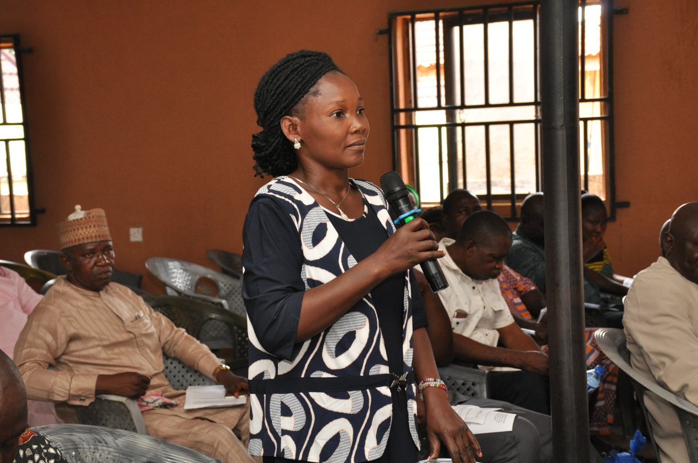
A stakeholder from the lga contributing to the discussion

Slide 25
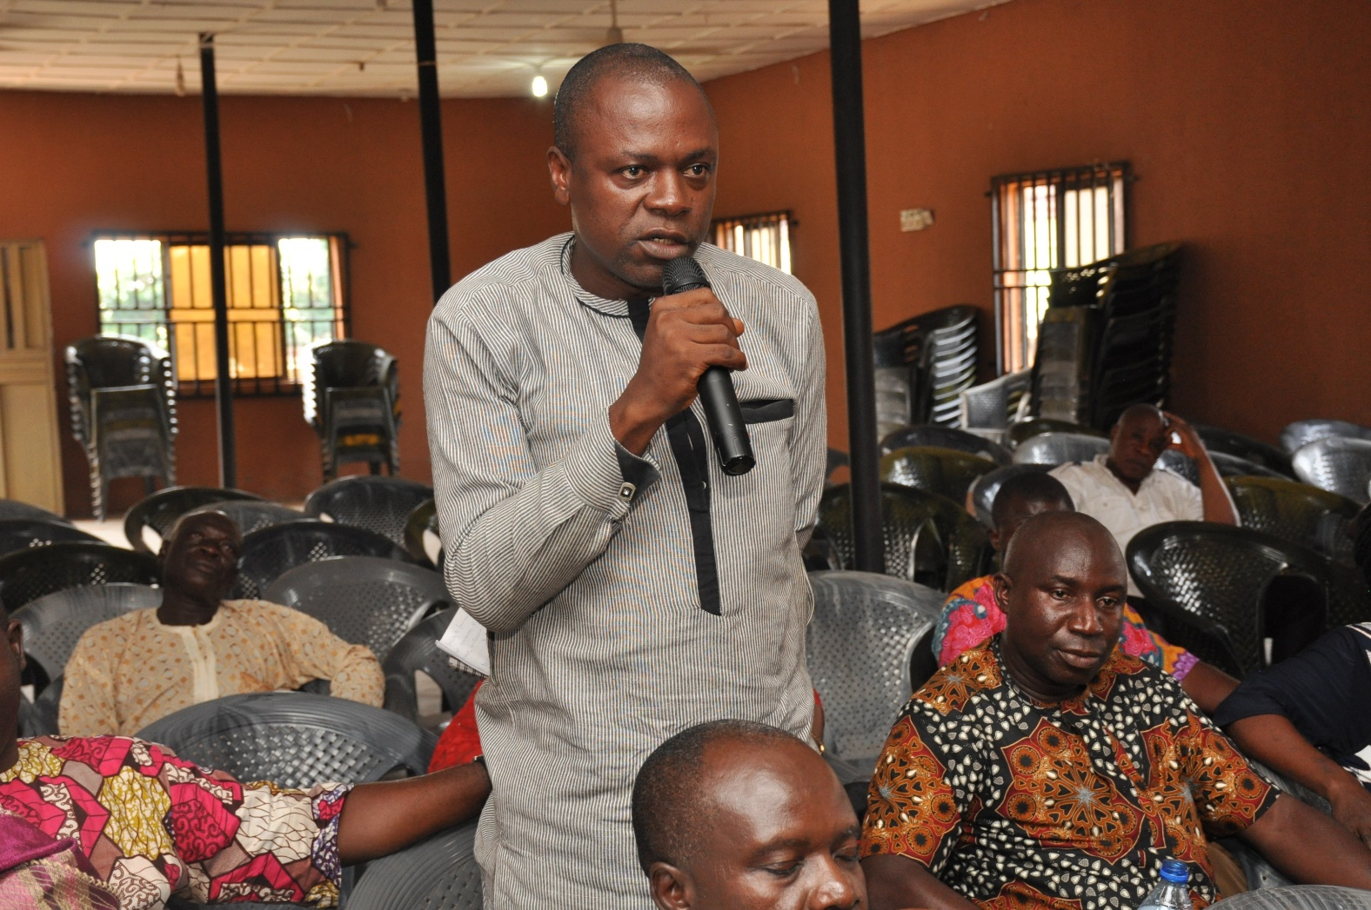
A representative from the ministry of agriculture explaining the ministry’s position.

Slide 26
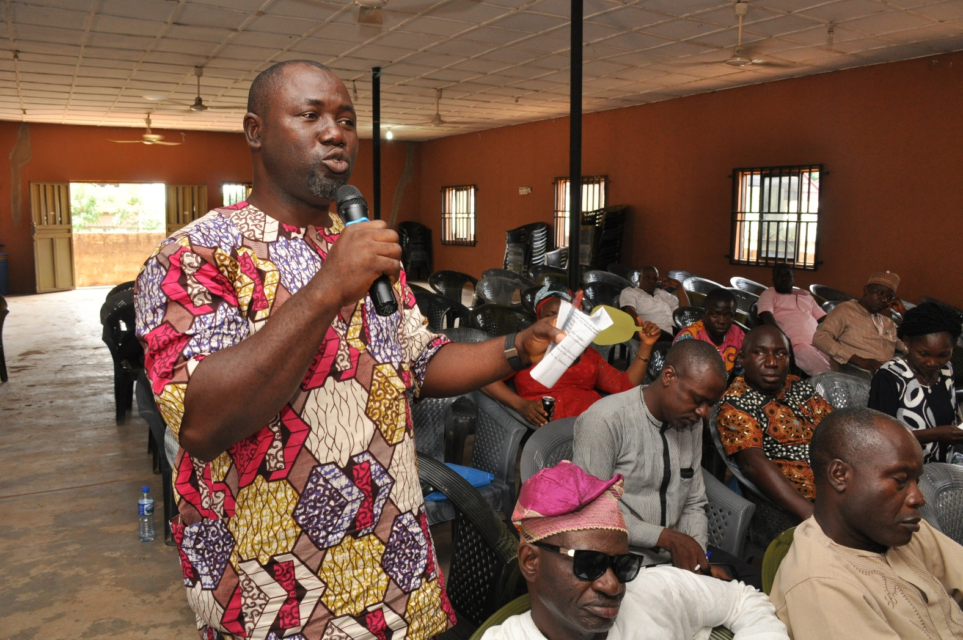
Representative from the ministry of rural development explain the ministry’s position.

Slide 27
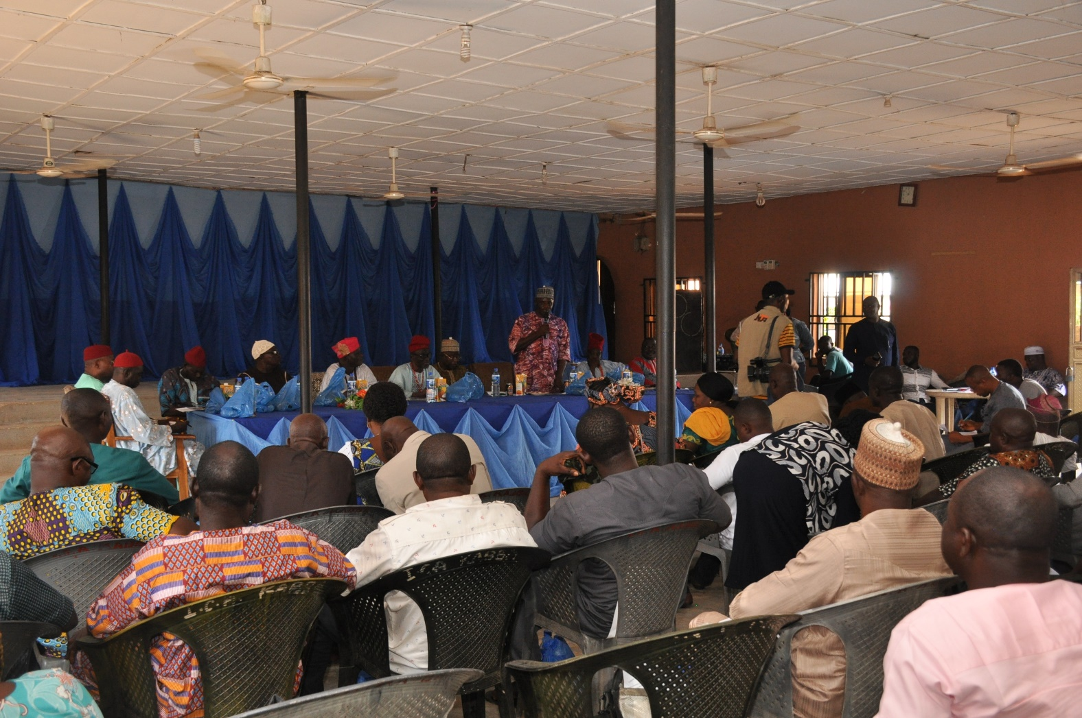
A cross section of participant’s during the stakeholders engagement

Slide 28
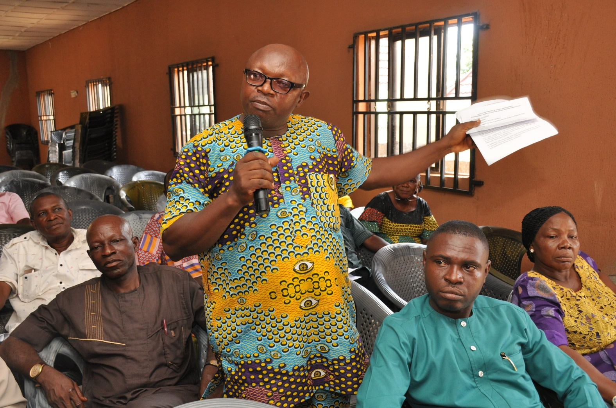
A participant from the lga explaining some point

Slide 29
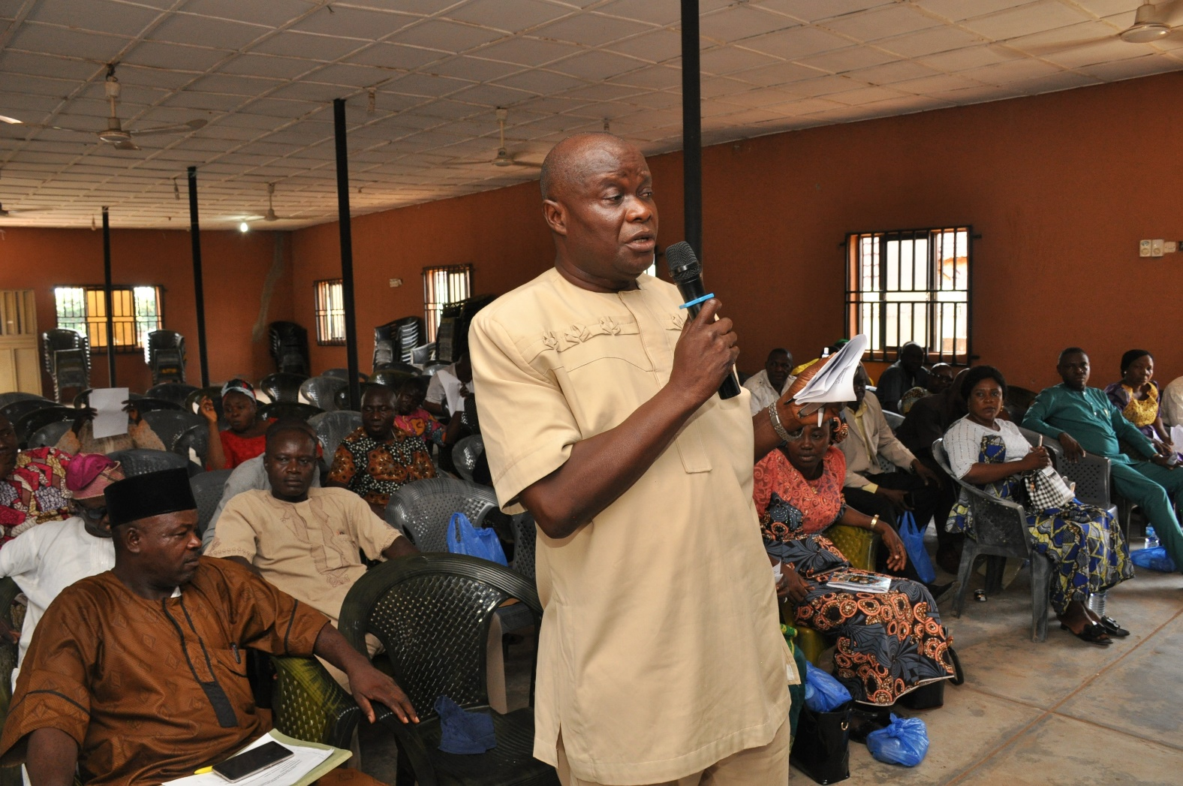
Director planning responding to the discussion

Slide 30
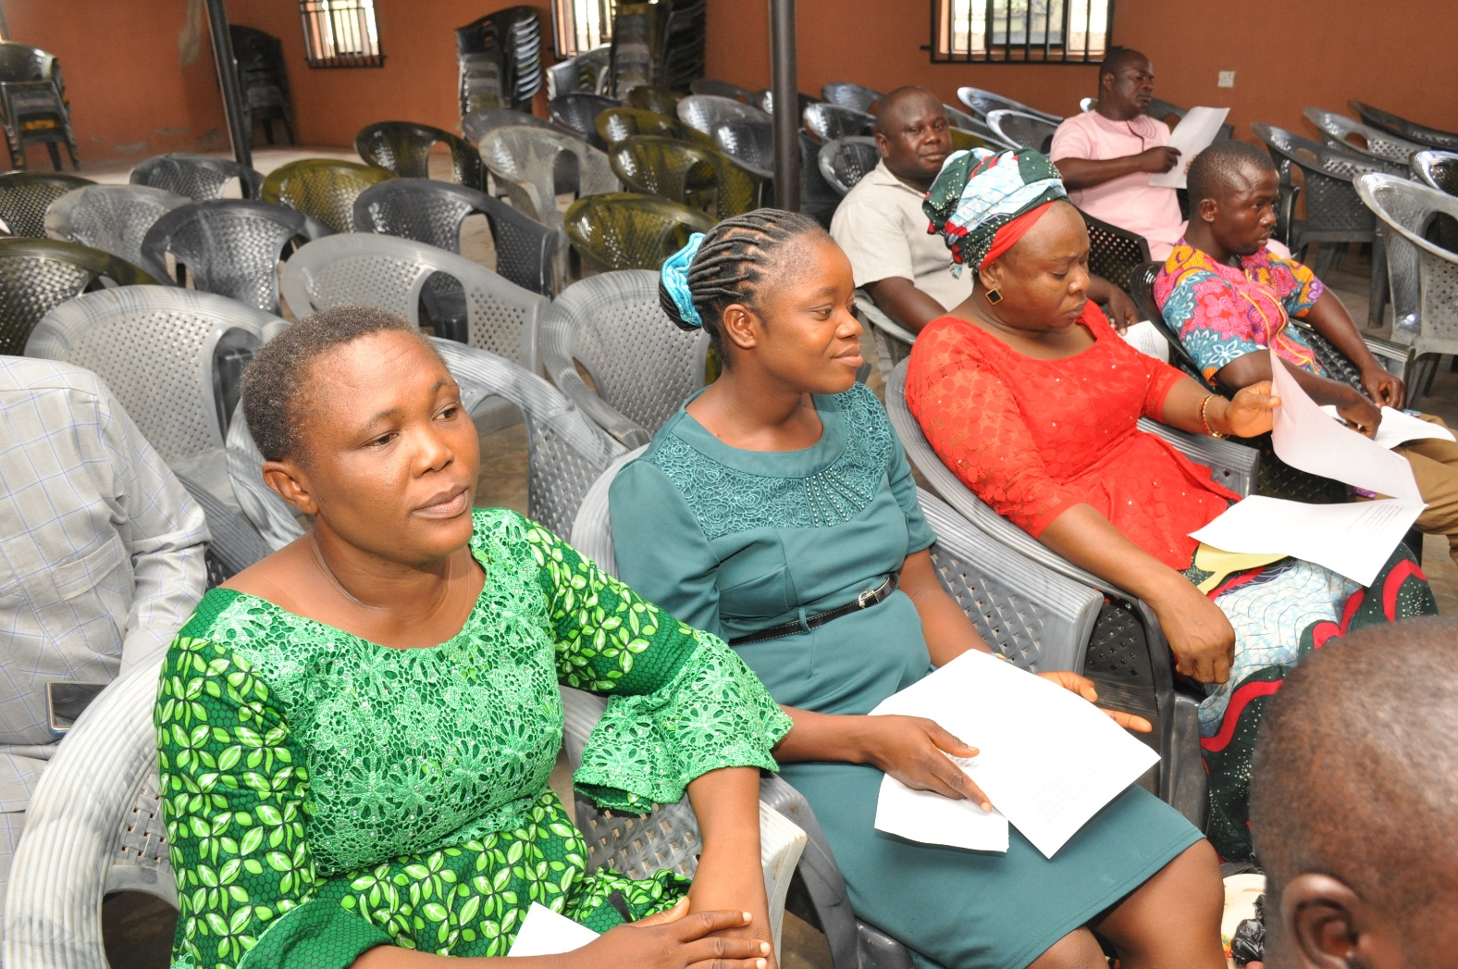
technical staff from budget dept. on active duty during the stakeholders meeting.

Slide 31
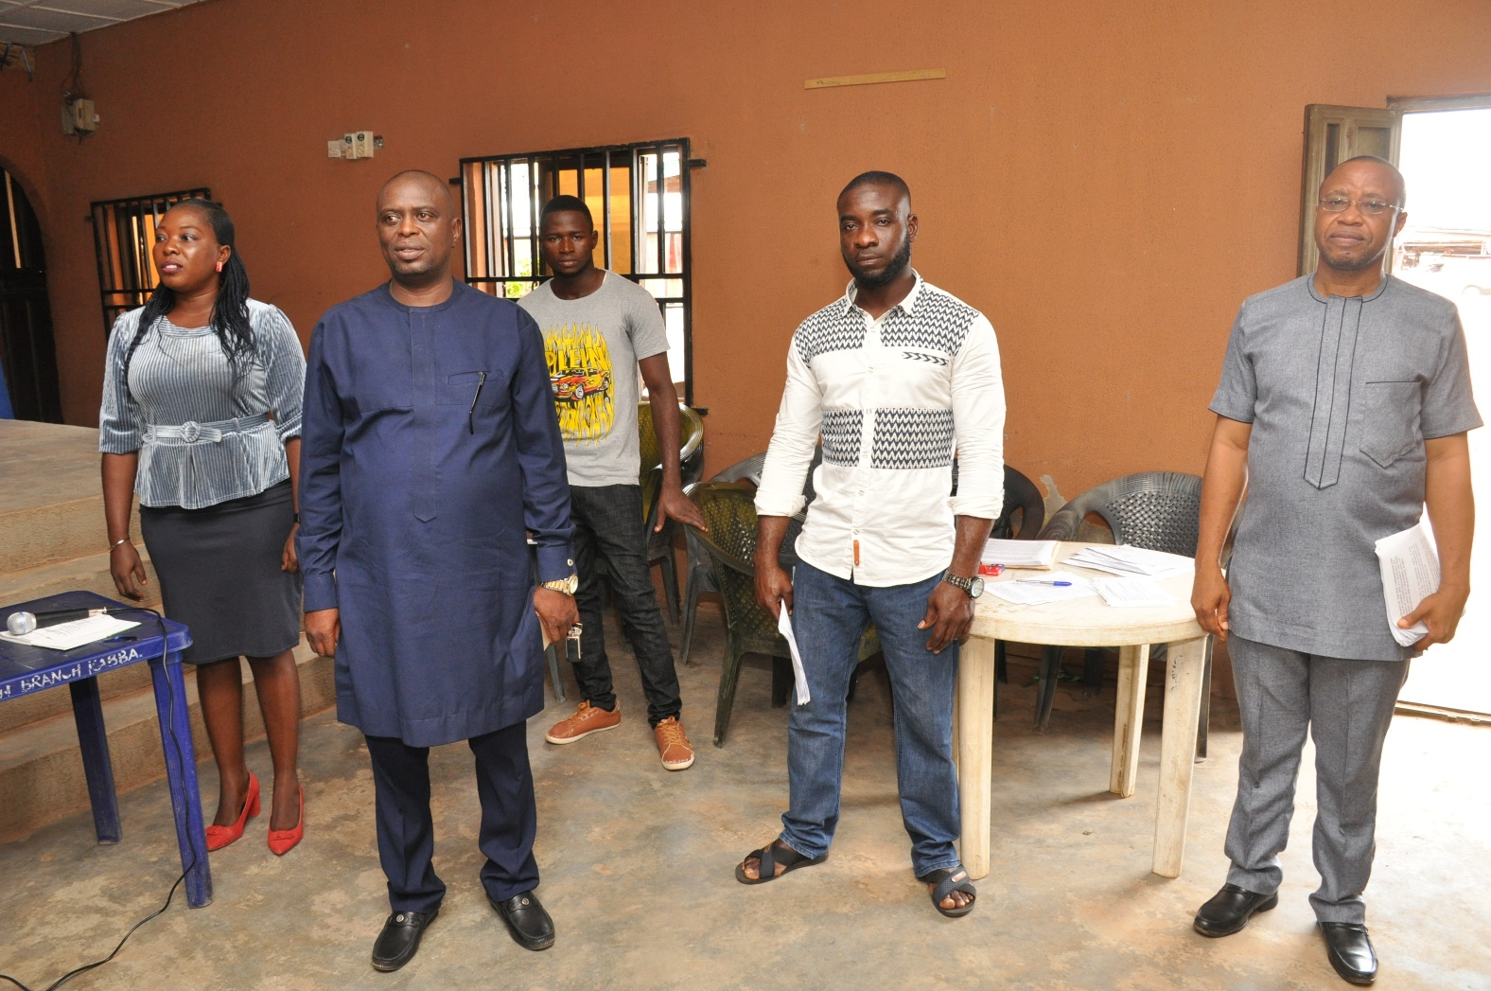
Technical staff of the budget dept. on active duty

Slide 32
A cross section of participants at the stakeholders meeting.

Slide 33
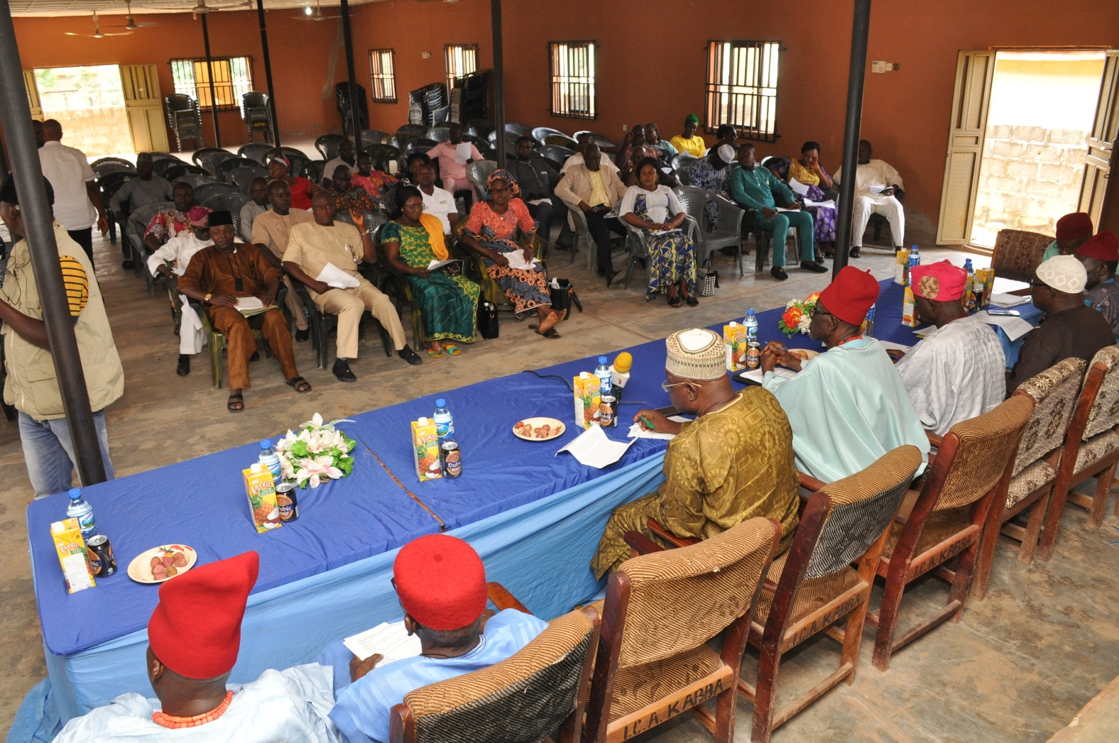
A cross section of participants during the stakeholders engagement

Slide 34
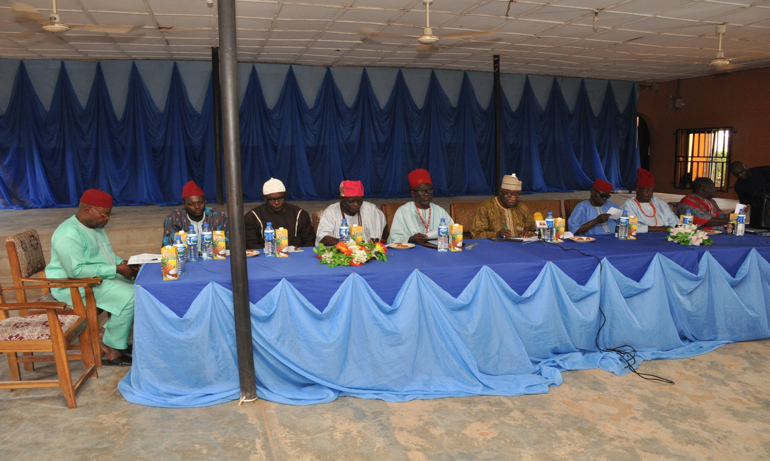
Royal fathers at the stakeholders engagement

Slide 35
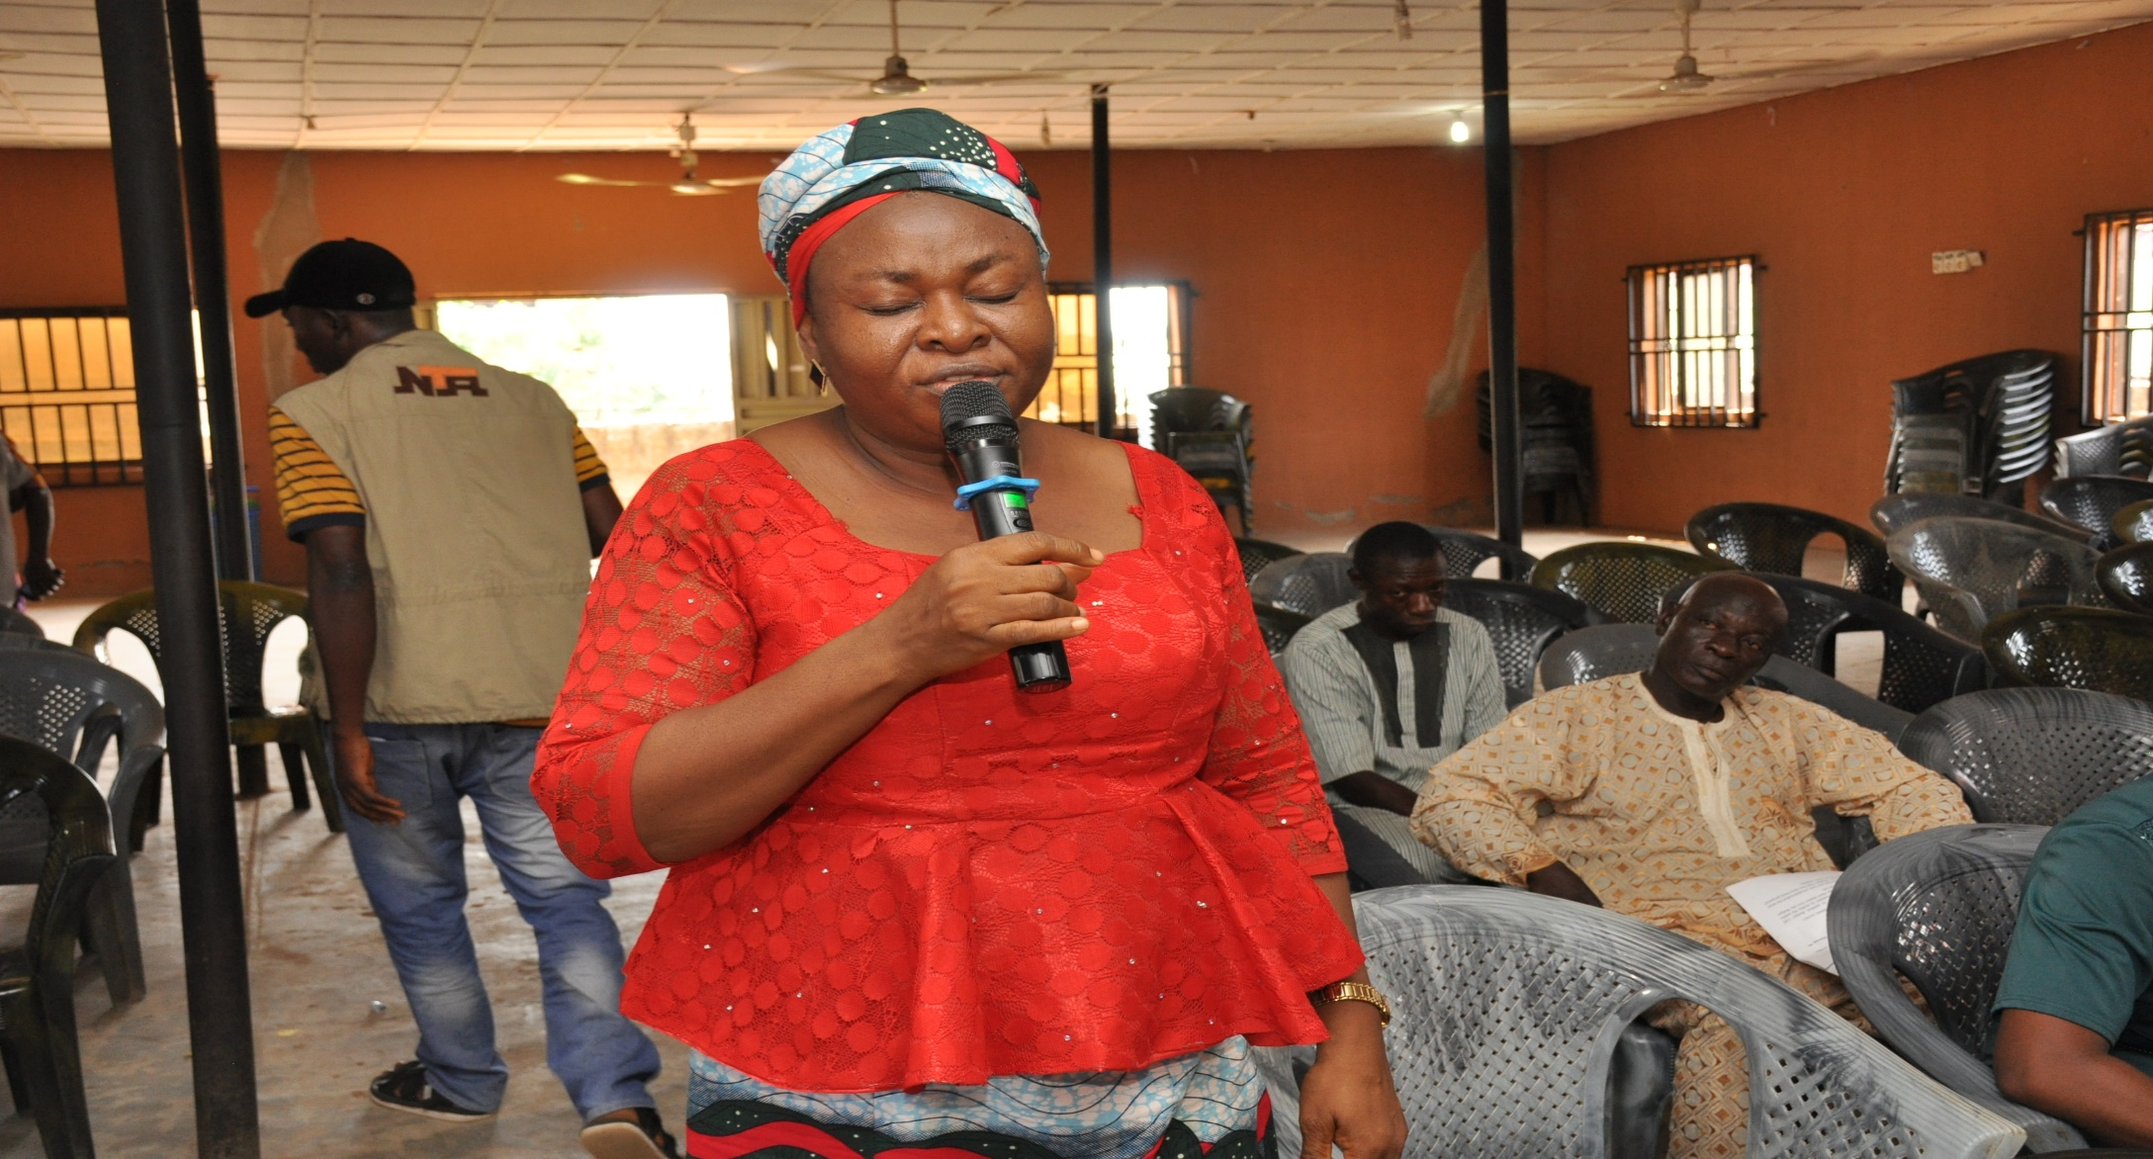
Mrs serah ocheje of the budget dept. delivering the closing prayers

Slide 36
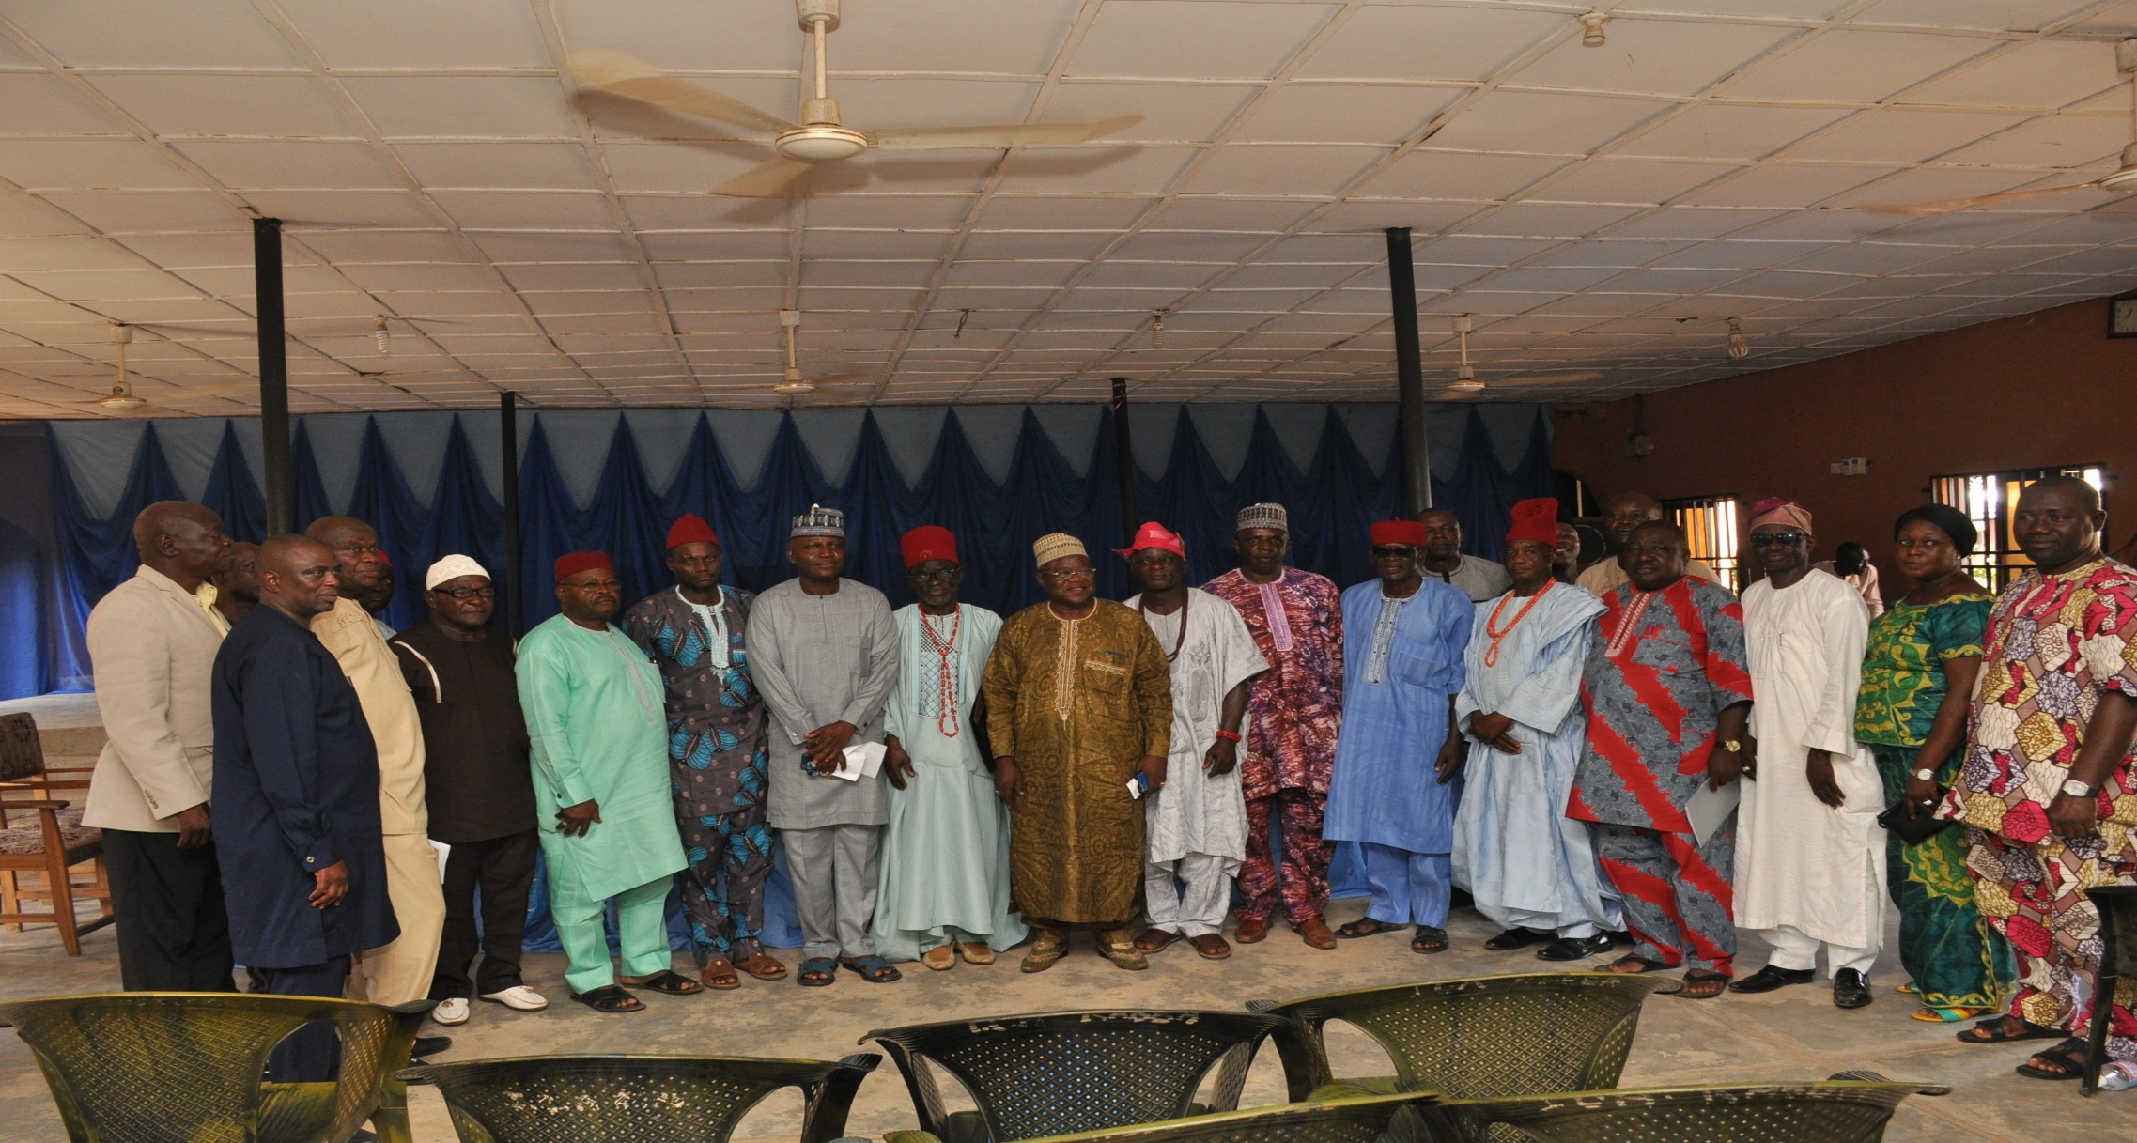
A group photograph of dignitaries at the event

